Slide 1
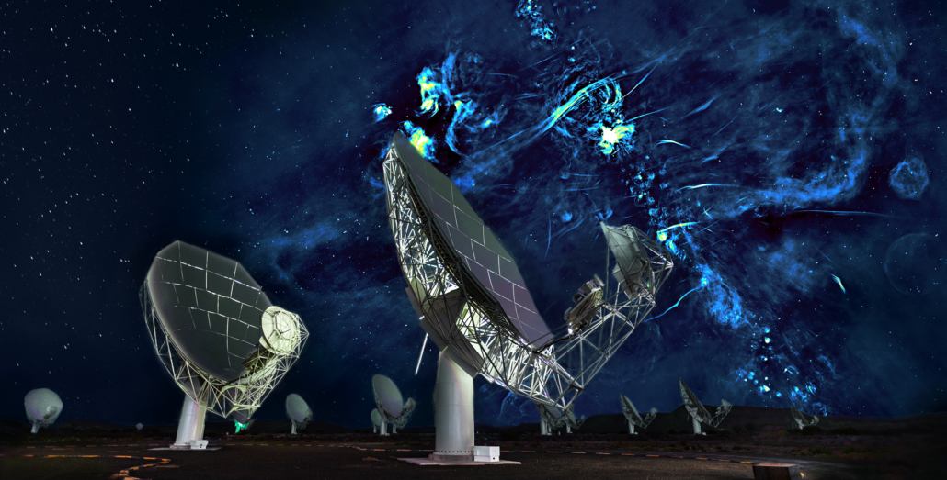
Understanding pulsar data with PSRCHIVE
Daniel Reardon (Swinburne/OzGrav) Many slides from Andrew Zic, Ryan Shannon, and James McKee
Notes:
Present how we have limits on GW levels to constrain the massive black hole population

Slide 2
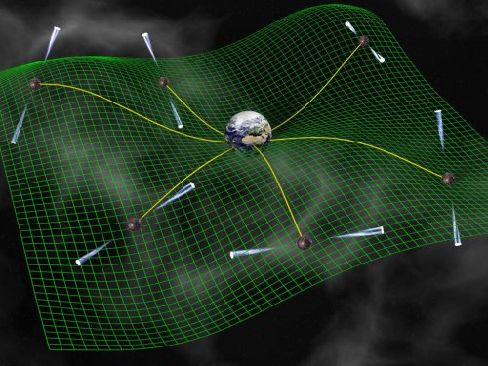
Motivation
Pulsars enable high precision astrophysics
Gravitational waves
General relativity
Matter at extreme density
Interstellar plasma, neutron star interior and magnetosphere, solar system and solar wind, stellar astrophysics, and more!
We want to do the bests tests possible
Need the best telescopes
Need the best instrumentation
Need the best data sets and tools to analyze them
Q: What does the data look like?
A: Use PSRCHIVE to see!
Schematic representation of Pulsar Timing Array
Credit: David Champion
Telescope -> Receiver -> Backend -> Pulse profiles -> Time-tagging -> Timing residuals -> Physics

Slide 3
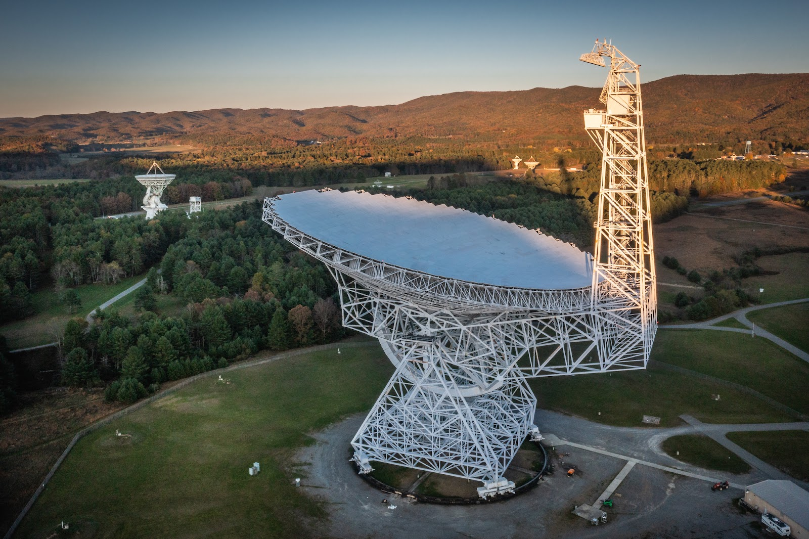
Antennas: the “body”
MeerKAT, South Africa (credit: SARAO)
Pulsars are faint
Large antenna size = large sensitivity
Historically: Large aperture single-dish telescopes
Don’t need angular resolution
Now: Interferometers
MeerKAT/LOFAR/VLA/SKA
Sites chosen for low radio-frequency inference
Works at observing frequencies of choice
FAST, China
Greenbank, USA (credit: Jay Young)

Slide 4
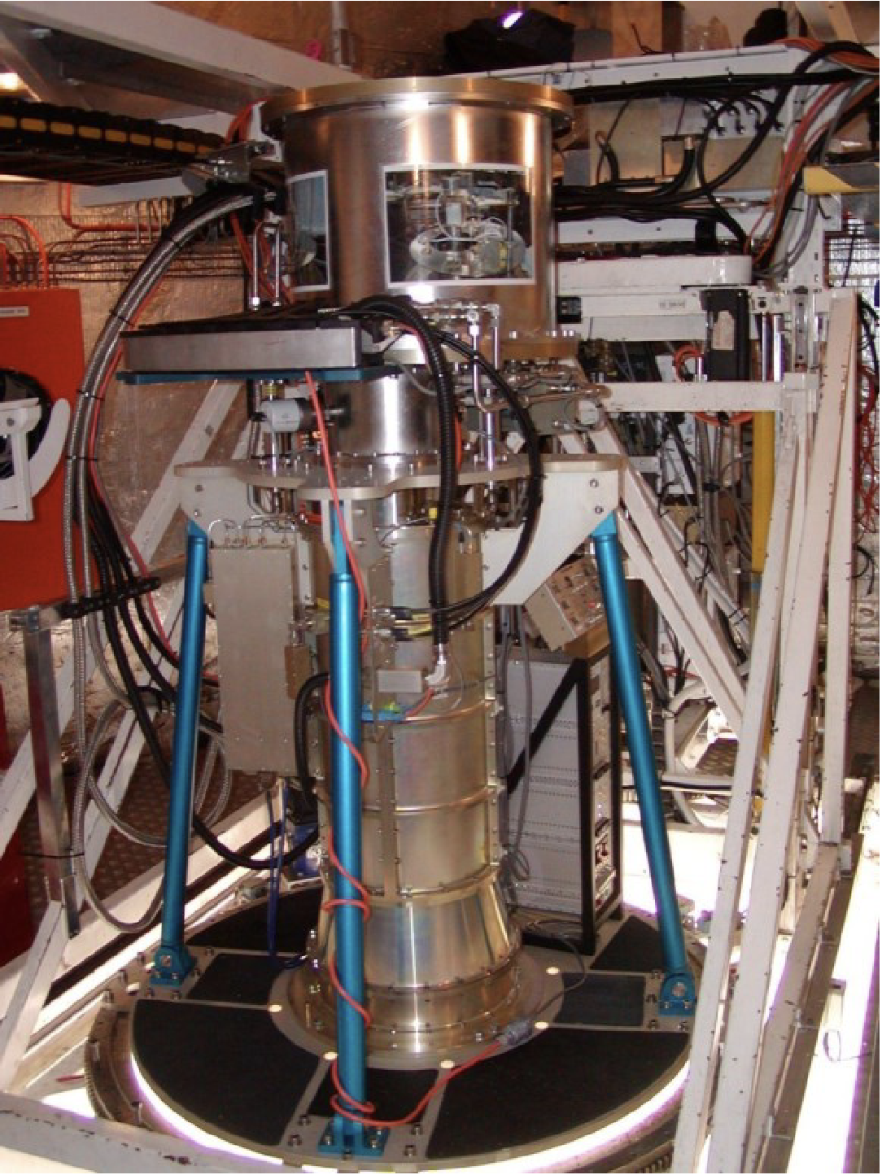
Receivers: the “heart”
"Frontend” – turns radio waves into electricity (voltages)
Choosing observing frequencies
Pulsars are brighter at lower frequency
The sky background is brighter at low frequency
The ionized gas in the interstellar medium affects low frequencies.
Precision pulsar timing is typically done between 600 MHz - 3 GHz (50 cm - 10 cm wavelengths)
System temperature
Adds randomness, “noise”, to the data
The lower the better
Can’t build expensive cooling systems for large arrays
Murriyang/Parkes 10-50cm dual band receiver

Slide 5
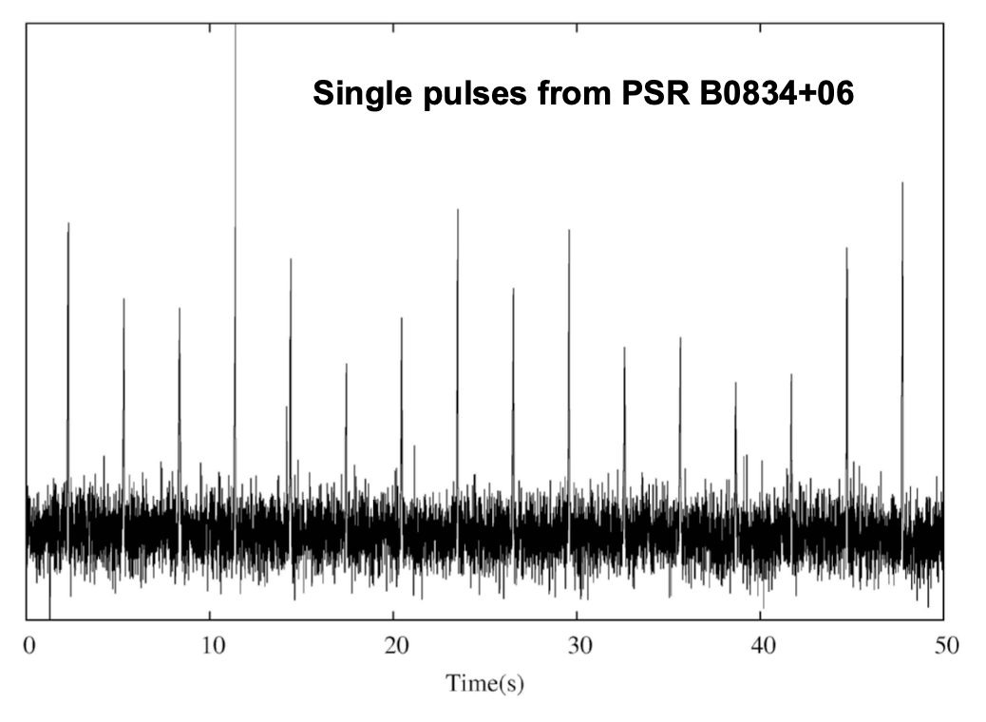
Backends: the “brains”
Digitize the electric signal (voltages)
time series from the frontend
Data processing
Channelization
Dedispersion
Phase binning
Time sampling
Data types:
Voltages -> Save everything and process later
Search mode -> Channelized high time resolution
Fold mode -> compact data cube for known pulsars. High time resolution in pulse phase
Pulses on first Australian $50 note

Slide 6
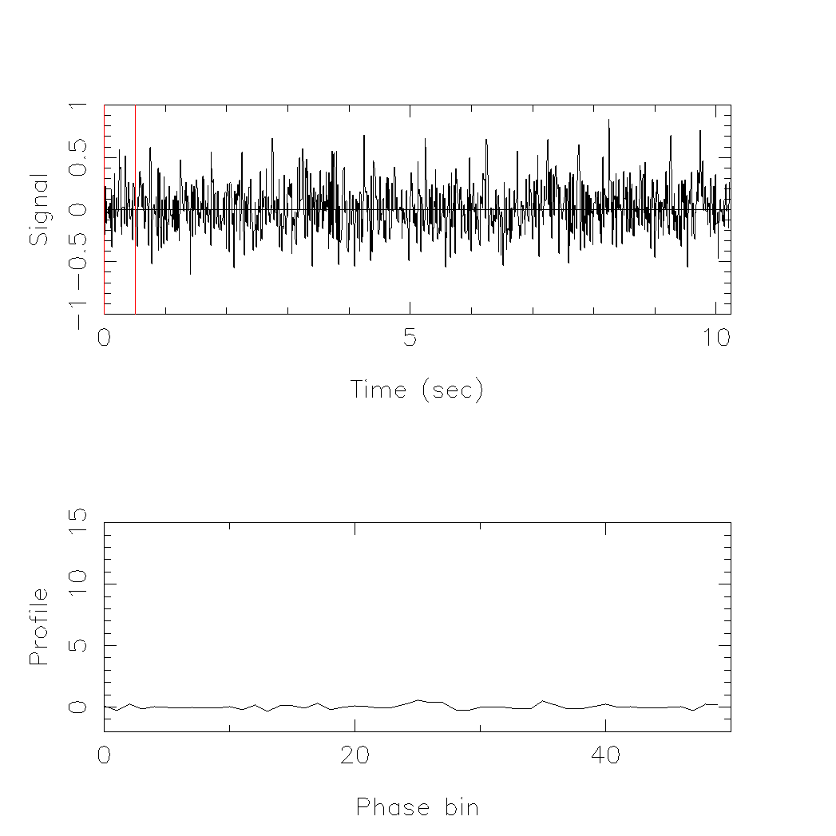
Pulsar folding
Pulsars are faint
For most pulsars observed with most telescopes, individual pulses are indistinguishable from the noise
Average together many pulses to get a clearer signal
In pulsar timing, we are studying known pulsars
We have a good model for the rotation of pulsar
Pulse period, P

Slide 7
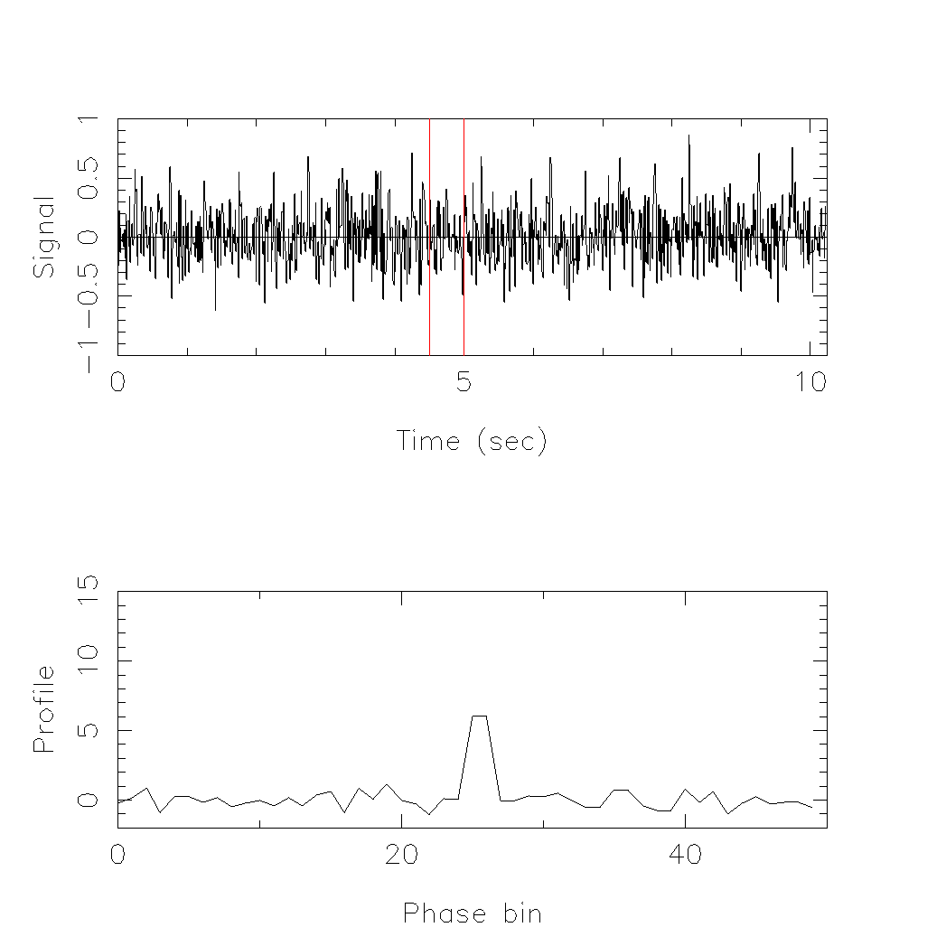
Pulsar folding
Pulsars are faint
For most pulsars observed with most telescopes, individual pulses are indistinguishable from the noise
Average together many pulses to get a clearer signal
In pulsar timing, we are studying known pulsars
We have a good model for the rotation of pulsar

Slide 8
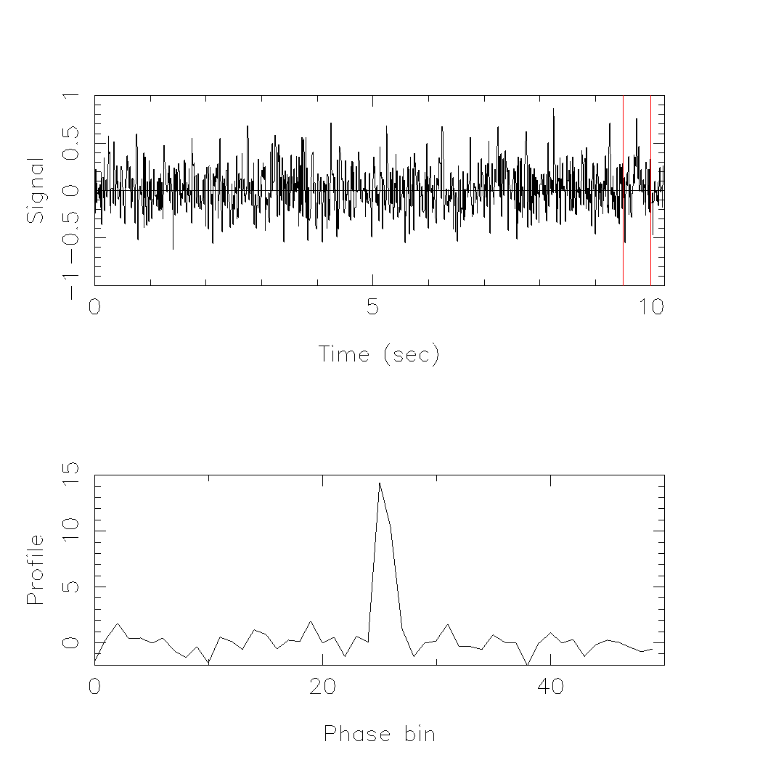
Pulsar folding
Pulsars are faint
For most pulsars observed with most telescopes, individual pulses are indistinguishable from the noise
Average together many pulses to get a clearer signal
In pulsar timing, we are studying known pulsars
We have a good model for the rotation of pulsar

Slide 9
Fold mode data cube
PDFB4
psrchive is used to process these data
One pulse profile per:
Frequency channel
Time sub-integration
Polarization
PSRCHIVE lets us explore this fold-mode data hyper-cube.
Archive files
each point in slab is a pulse profile
time
CASPSR
polarisation
frequency

Slide 10
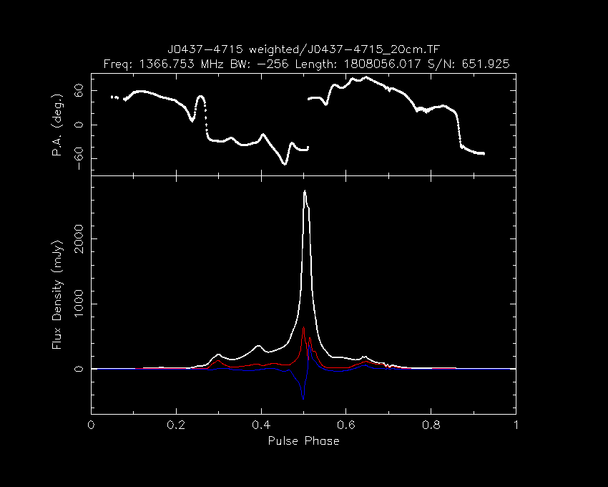
Pulse profile
Linear polarization position angle
White: total intensity
Red: linear polarization
Blue: circular polarization
Profiles can have microsecond time resolution
Dai et al. (2015)

Slide 11
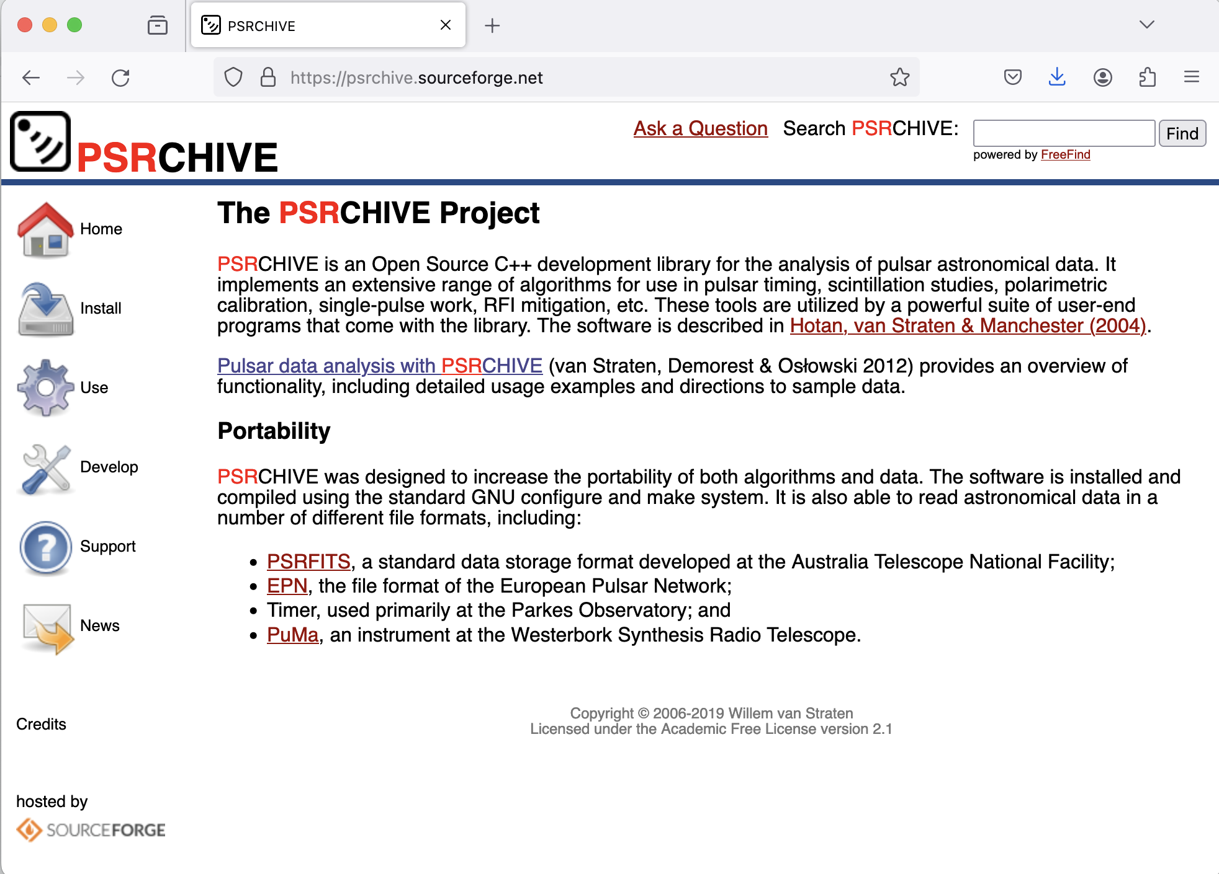
What is PSRCHIVE?
A software suite, not a single monolithic program:
Integrated with UNIX environment
A C++ development library with python bindings
Open-source
Powerful
https://psrchive.sourceforge.net/index.shtml

Slide 12
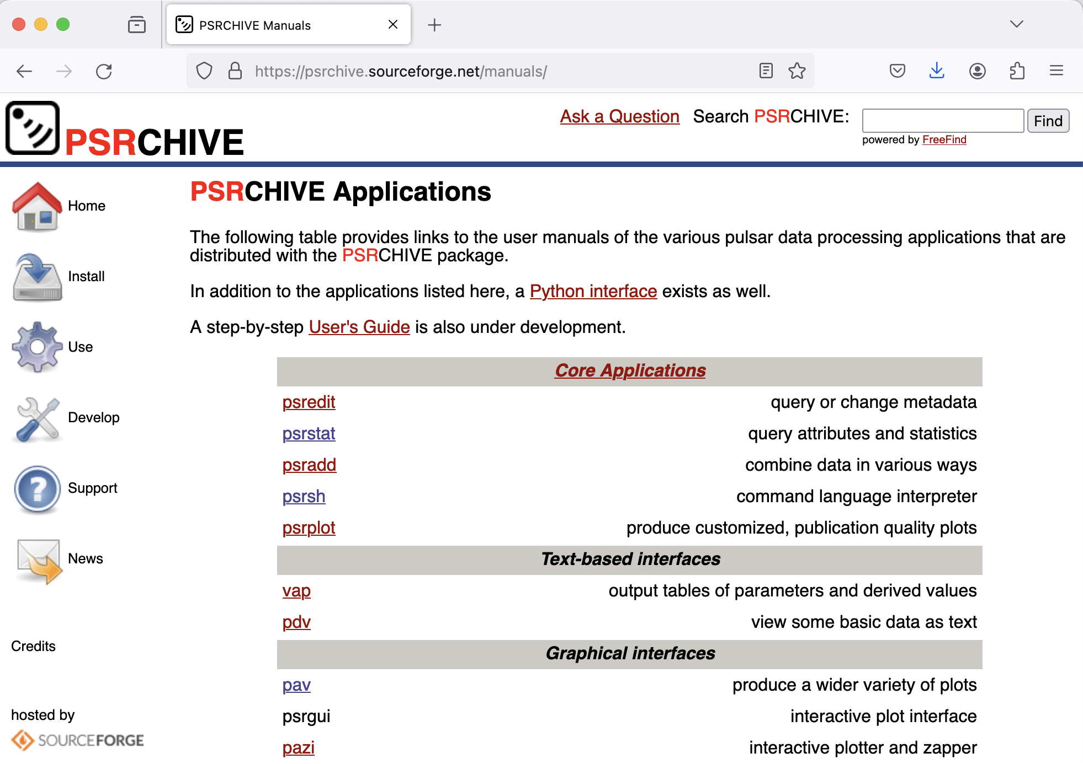
Resources for PSRCHIVE
https://psrchive.sourceforge.net/manuals
Bonus: IPTA student week 2024 tutorial:
https://github.com/andrewzic/IPTA_PSRCHIVE_tutorial_2024

Slide 13
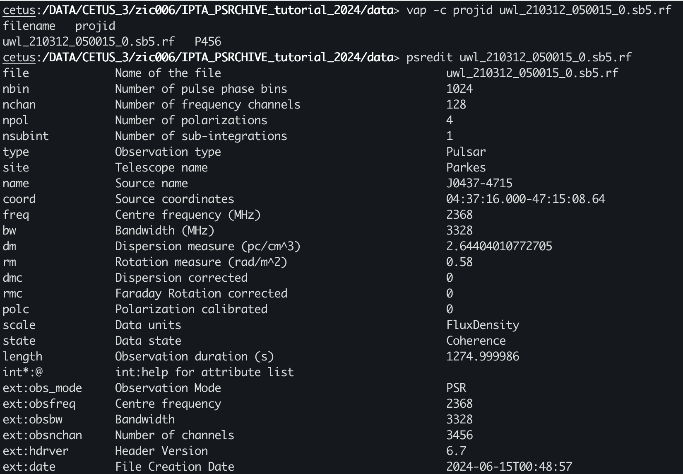
What can PSRCHIVE do?
Inspect (and edit) archive metadata (psredit, vap)

Slide 14
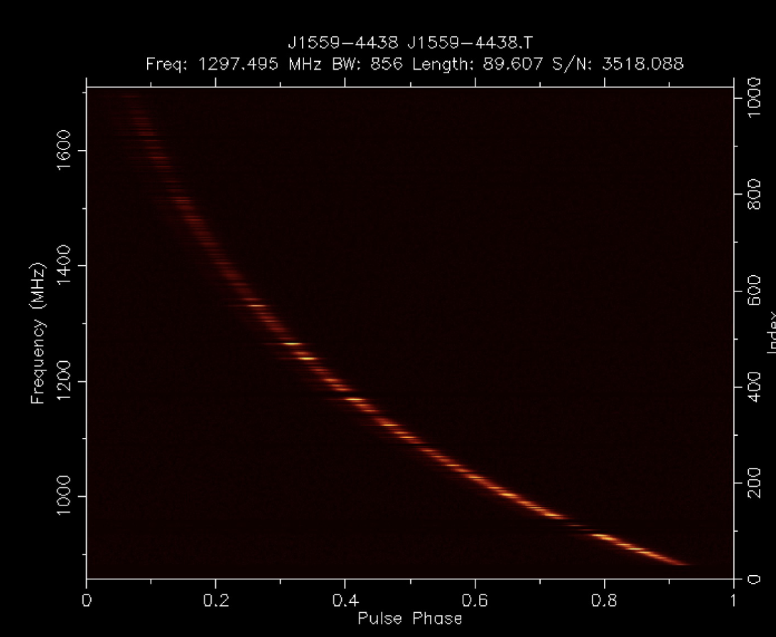
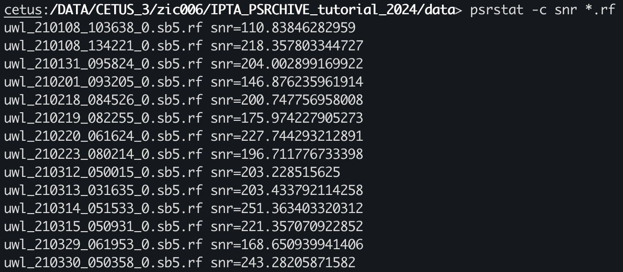
What can PSRCHIVE do?
Compute statistics (psrstat, pdv)
Modify data products (psrsh, pam):
Time, frequency, polarization averaging
De-dispersion
Dispersed pulse as a function of frequency

Slide 15
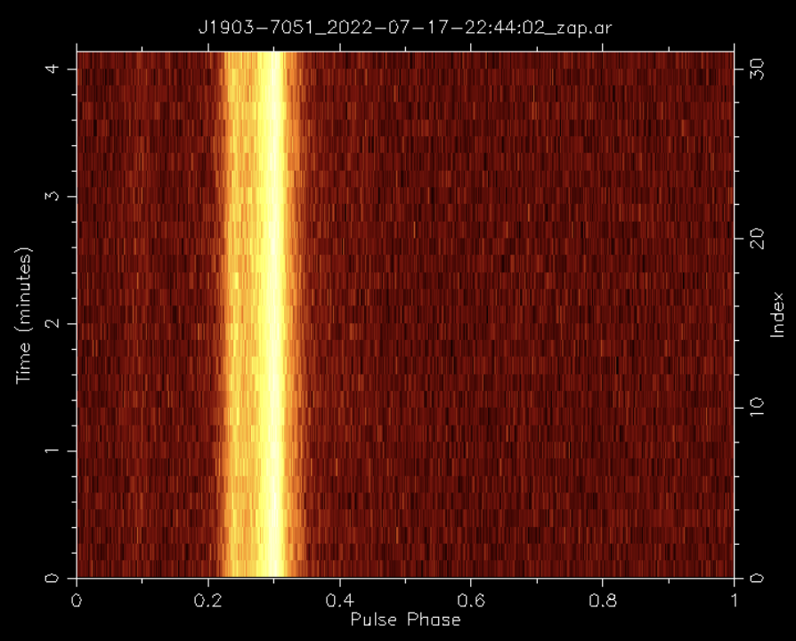
What can PSRCHIVE do?
Visualise data (psrplot, pav)
Profile vs time
Profile vs frequency
Profile polarisation

Slide 16
Profiles with frequency
Physics!
Dispersion
Interstellar medium disperses radio waves
Low frequencies arrive later than high
Pulsar intrinsic spectrum
Pulsars typically brighter at low frequency
Pulse width changes
High frequencies come from lower in the magnetosphere
Scattering / scintillation
Density fluctuations in the interstellar medium cause propagation and interference
Radio-frequency interference (RFI)

Slide 17
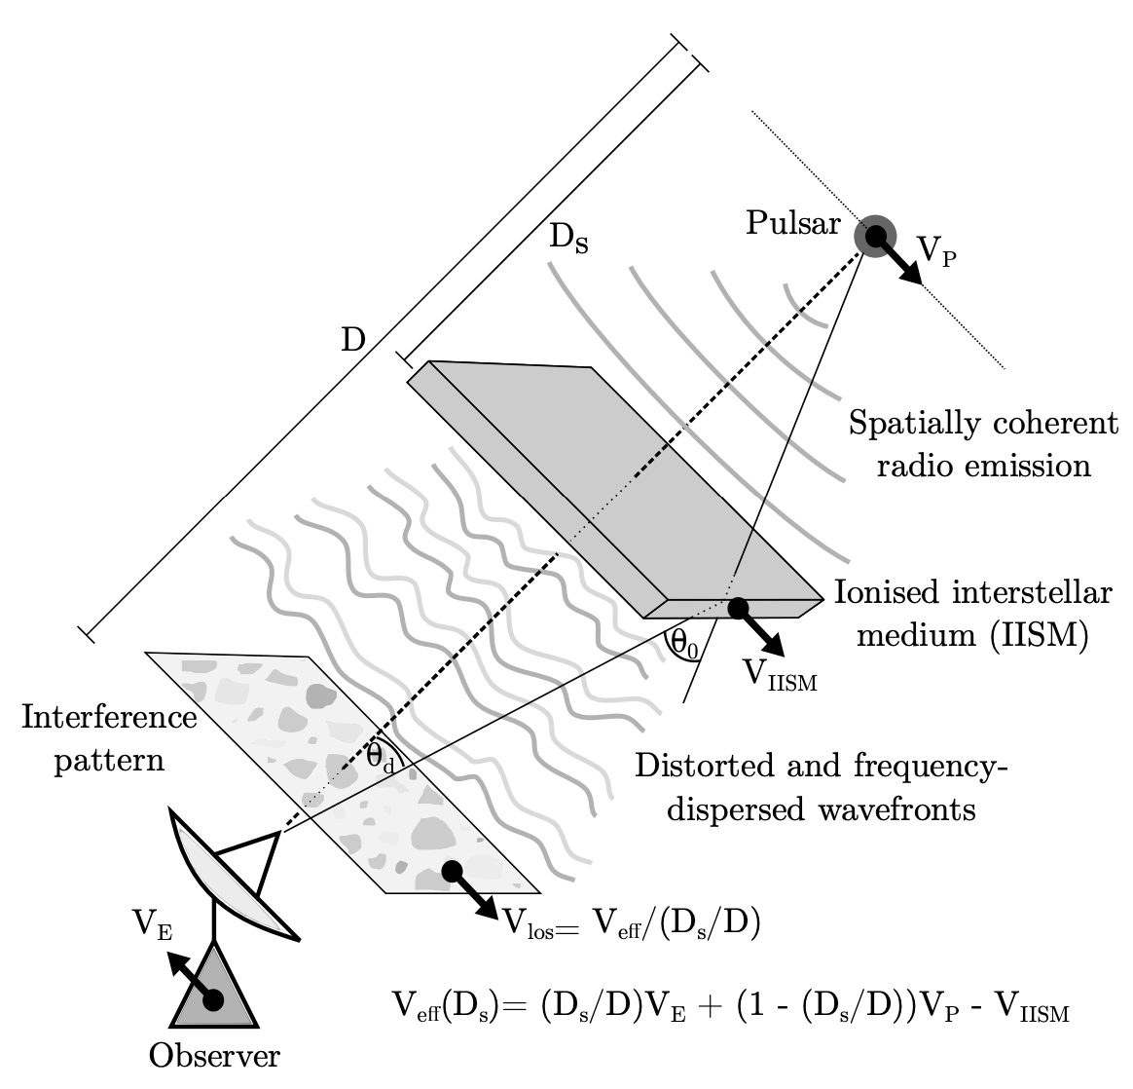
Profiles with frequency
Physics!
Dispersion
Interstellar medium disperses radio waves
Low frequencies arrive later than high
Pulsar intrinsic spectrum
Pulsars typically brighter at low frequency
Pulse width changes
High frequencies come from lower in the magnetosphere
Scattering / scintillation
Density fluctuations in the interstellar medium cause propagation and interference
Radio-frequency interference (RFI)

Slide 18
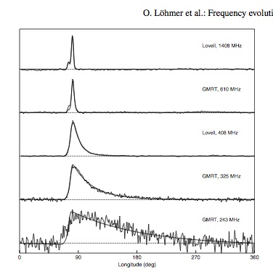
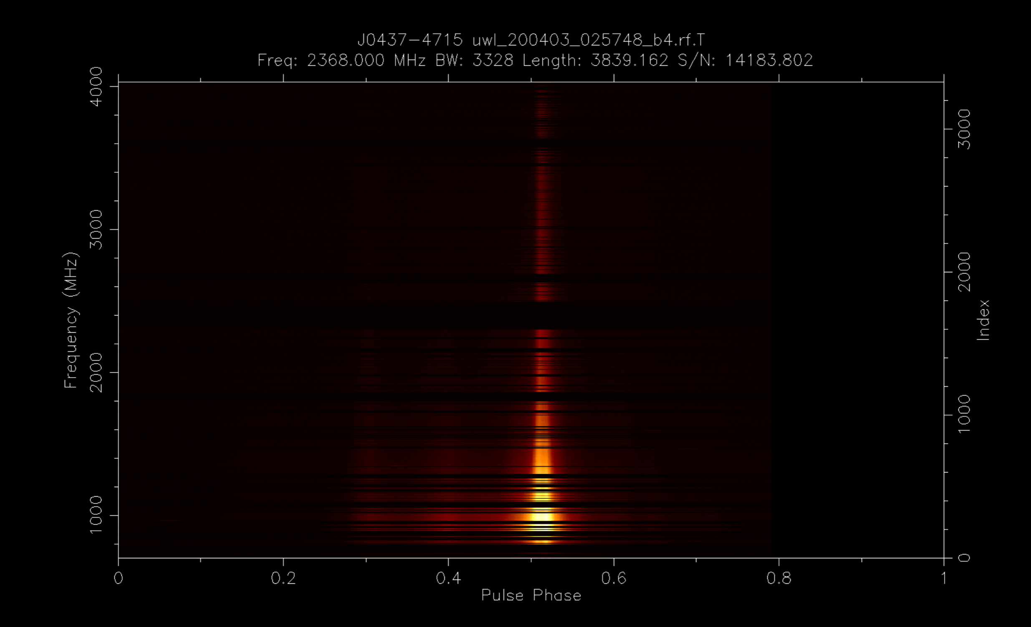
Profiles with frequency
Another pulsar profile versus frequency
the effect of scattering
Channels removed because of interference

Slide 19
Profiles with time
Right: Parthasarathy et al. (2021)
Physics!
Scintillation
Interference pattern moves as the Earth/pulsar/ interstellar medium move
Mode changing
The pulsar emission changes
Jitter
Random pulse shape and intensity variations make the brightness vary randomly
Bursts of RFI

Slide 20
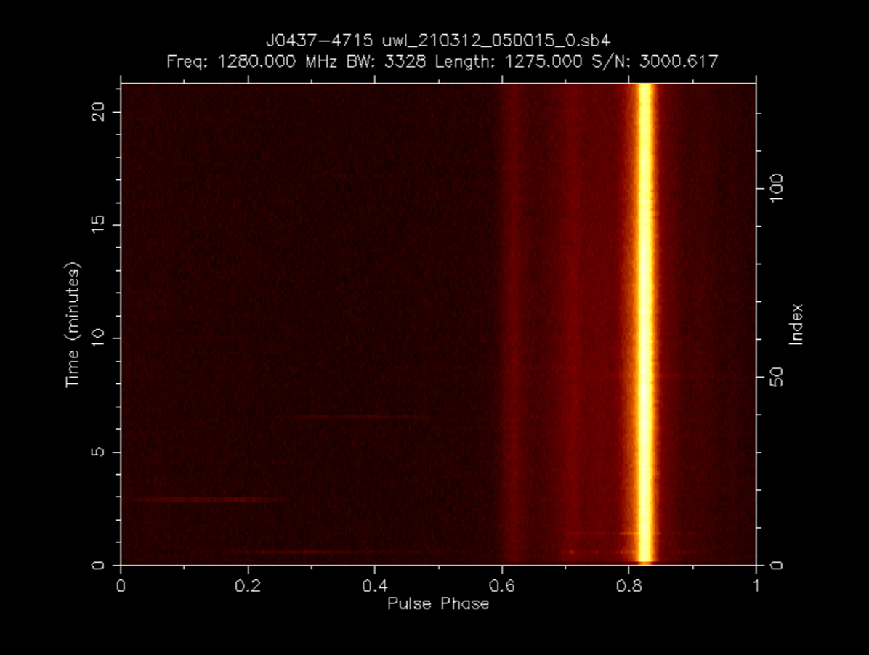
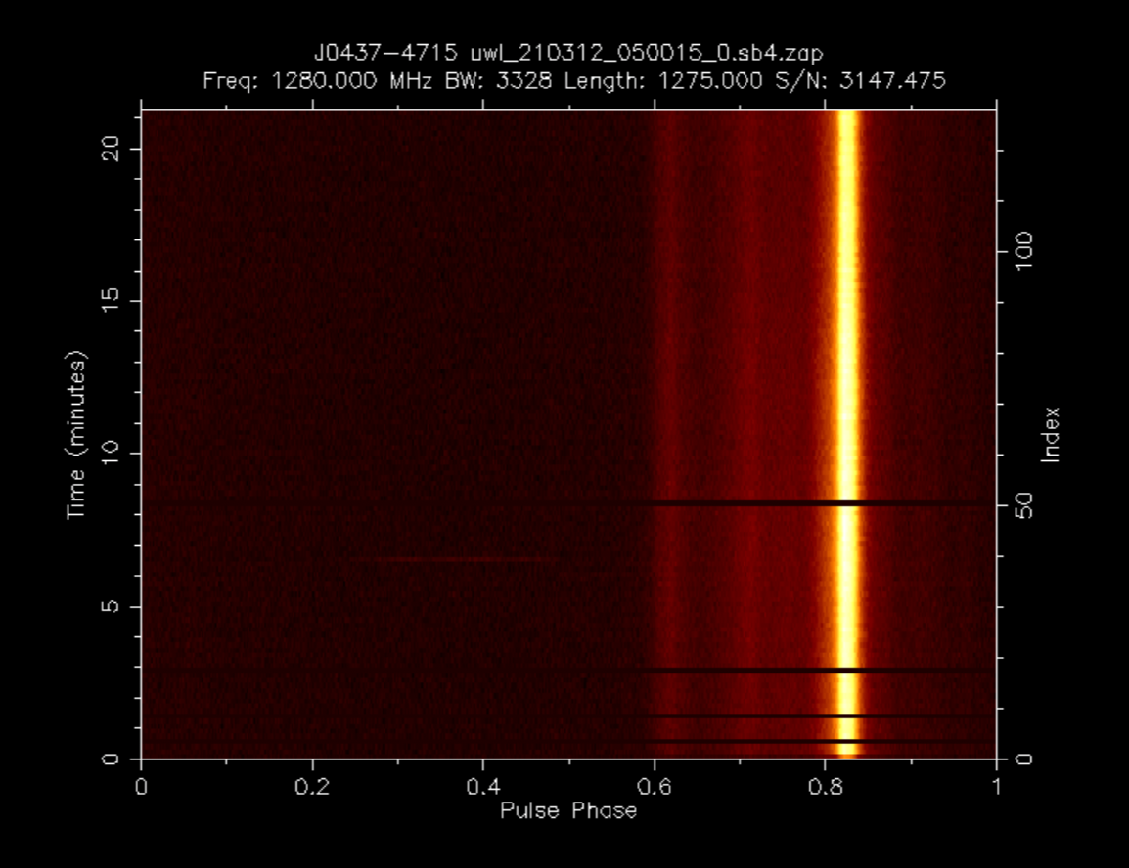
What can PSRCHIVE do?
Excise interference (paz, pazi)

Slide 21
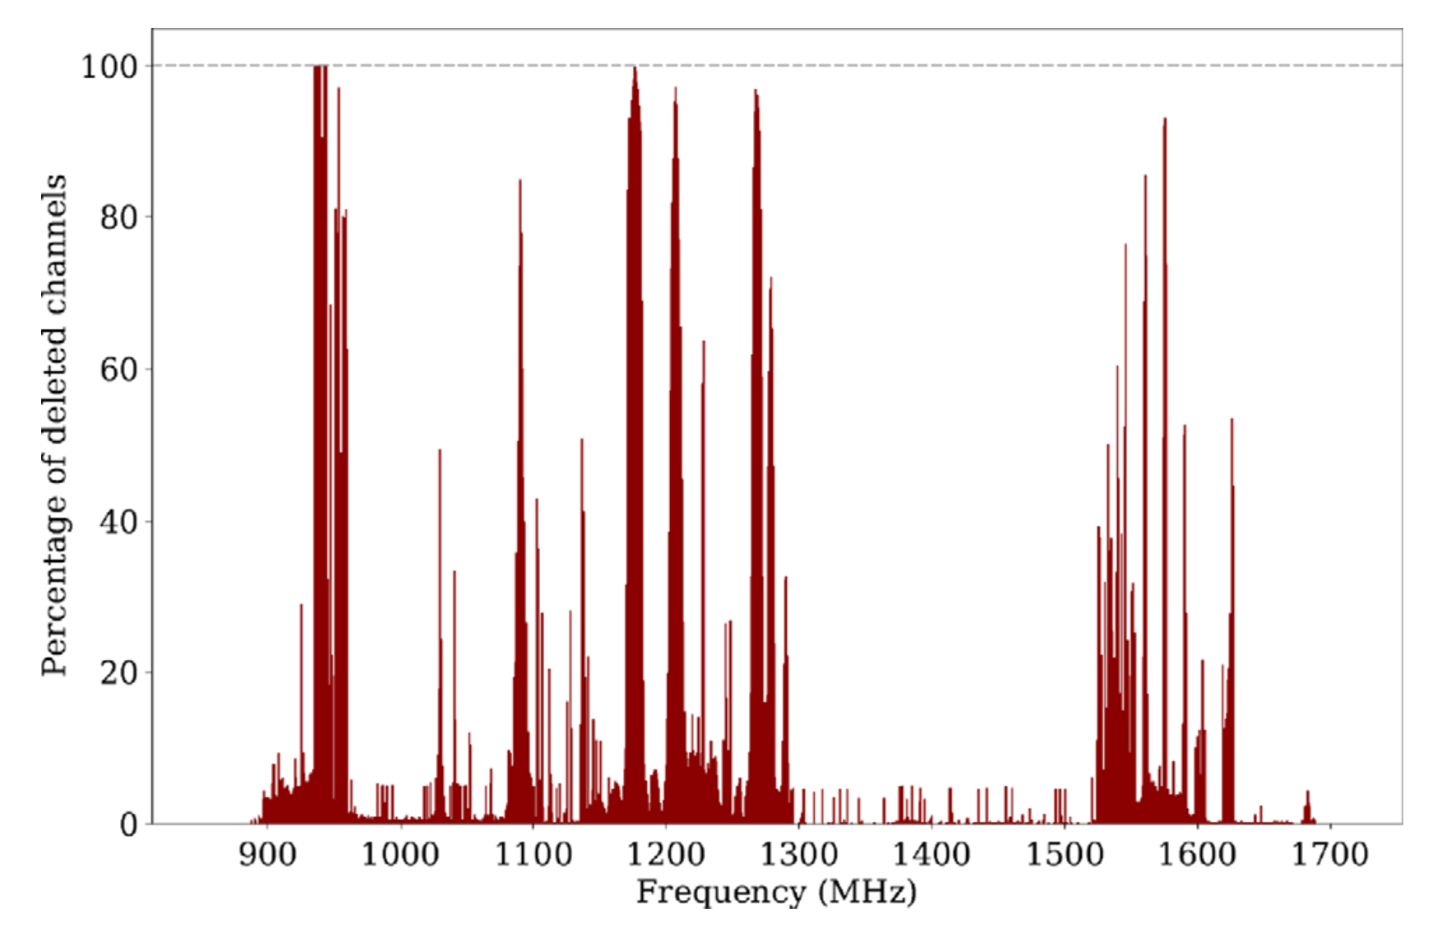
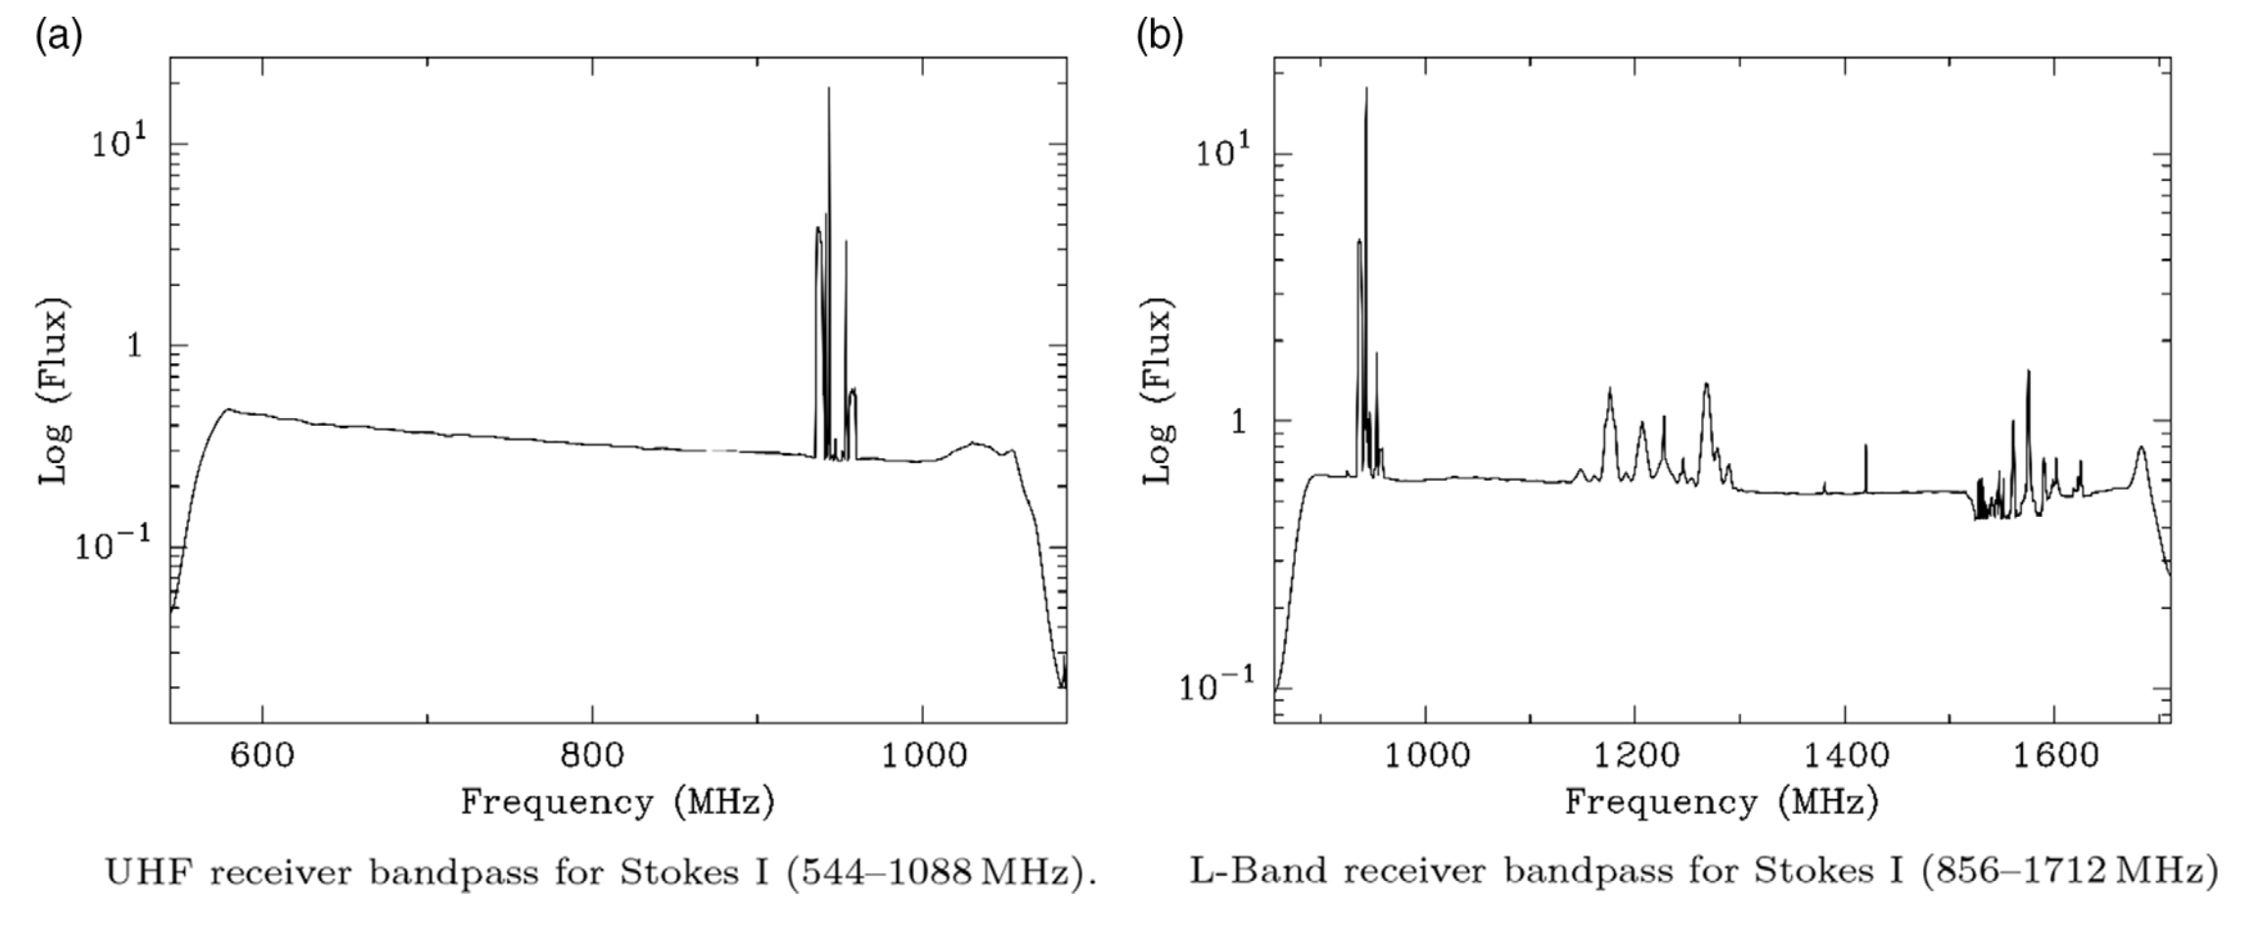
Radio-frequency interference
RFI is everywhere
Satellites, cell phone, wifi, planes, radio broadcast, lightning, microwaves
Above: Fraction of time a channel has been removed due to RFI at MeerKAT

Slide 22
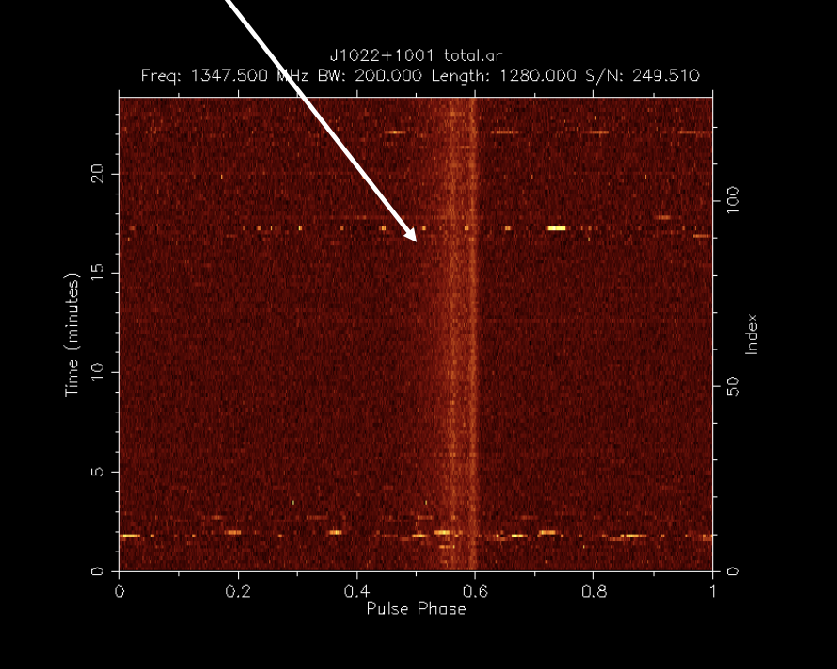
Radio-frequency interference in data
Narrow-band
Bursts

Slide 23
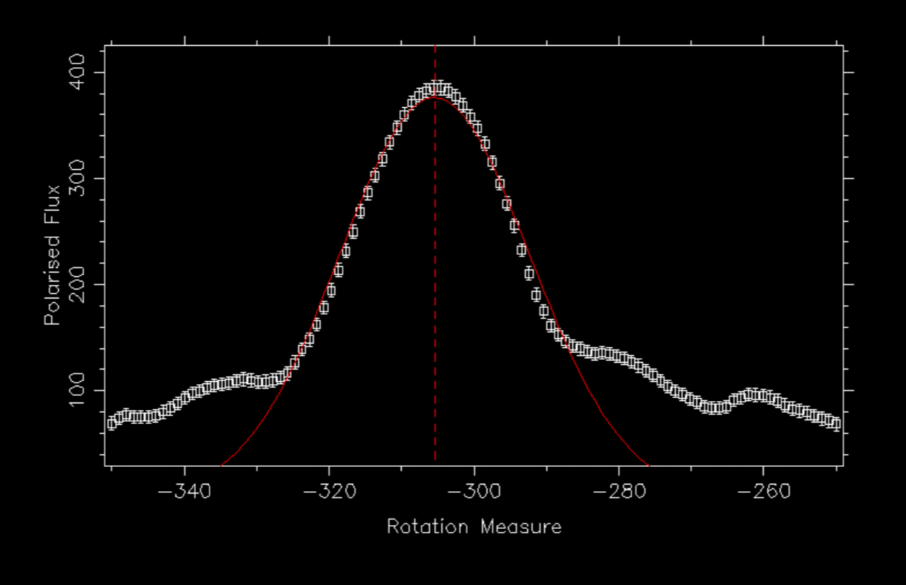
What can PSRCHIVE do?
Calculate and correct for rotation measure (rmfit)

Slide 24
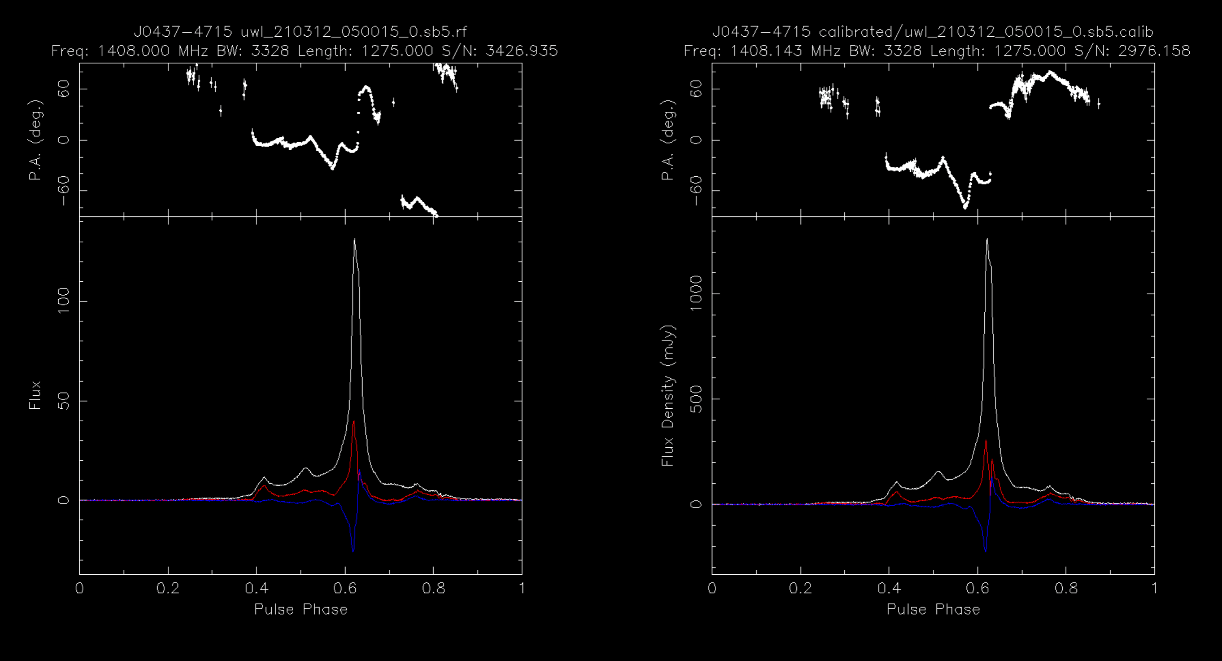
What can PSRCHIVE do?
Polarization/flux calibrate observations (pac, pcm)

Slide 25
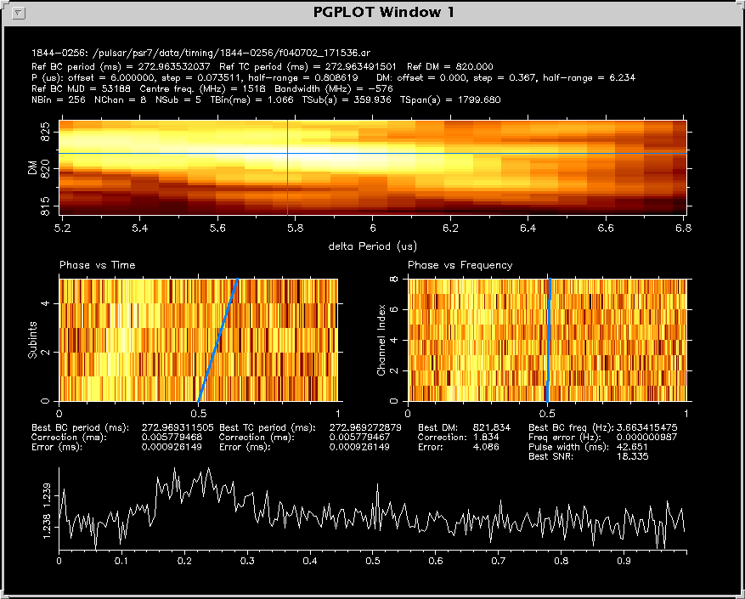
What can PSRCHIVE do?
Calculate optimal period and DM of pulsar candidates (pdmp)

Slide 26
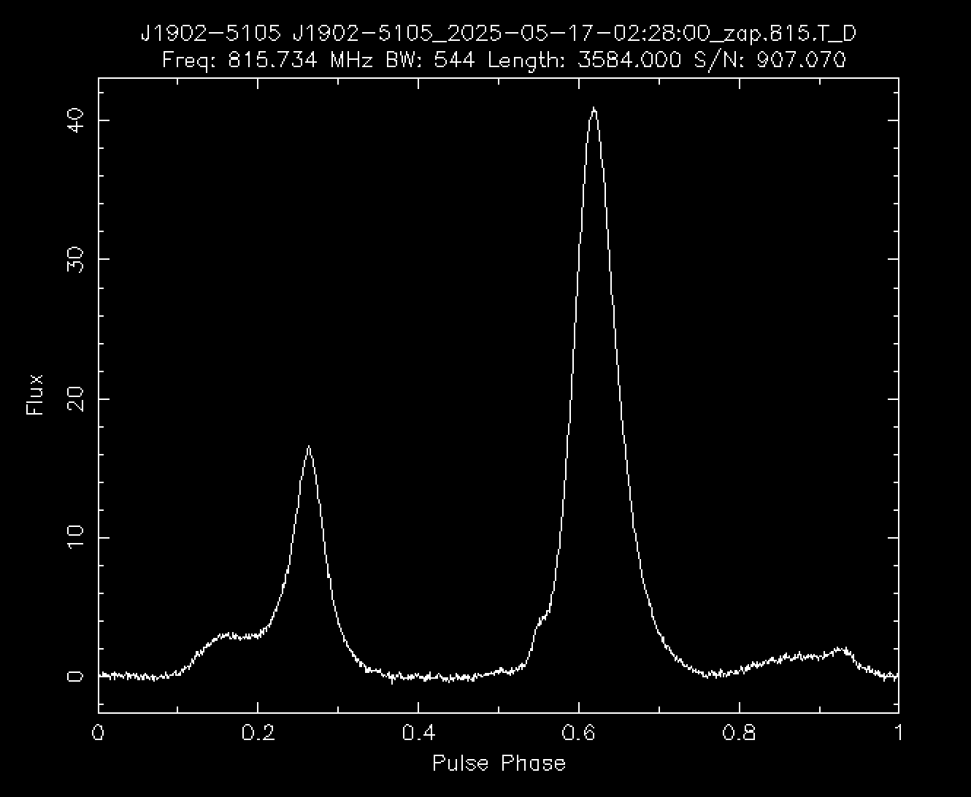
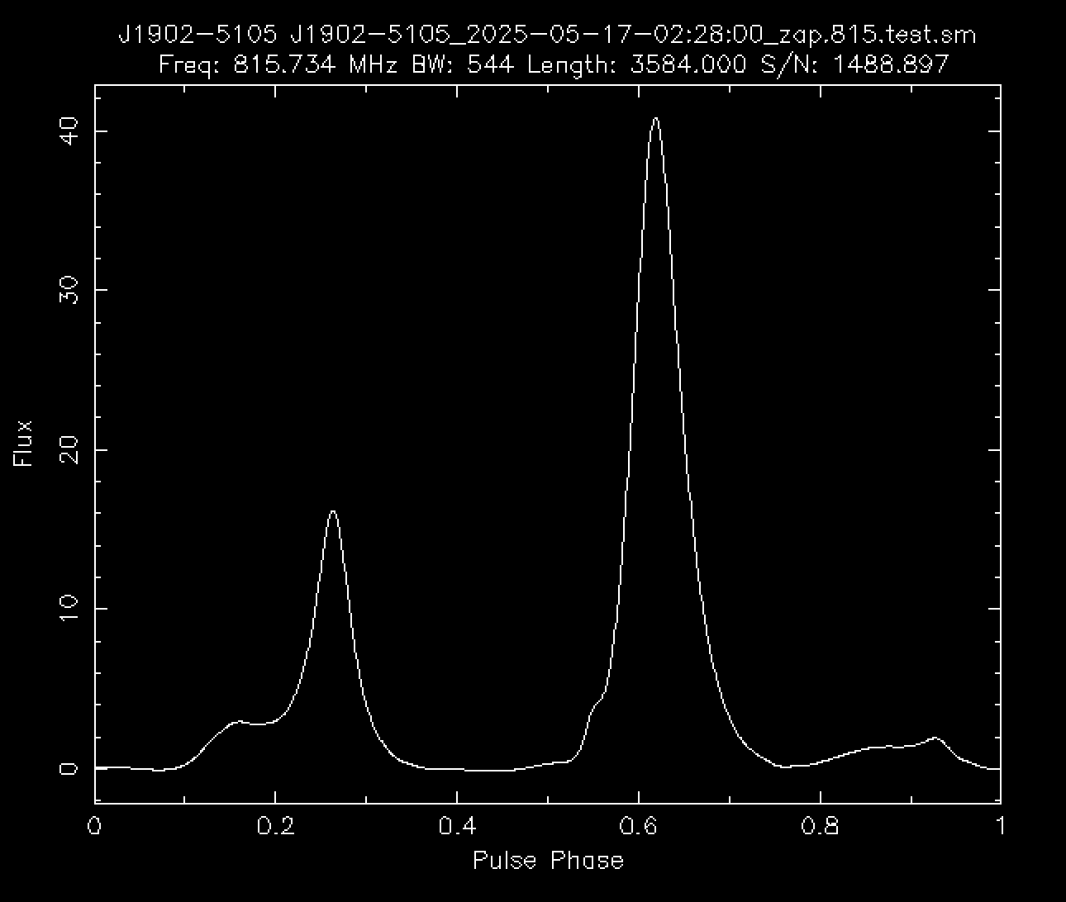
What can PSRCHIVE do?
Combine multiple observations (psradd)
Form standard templates for timing (psrsmooth, paas)

Slide 27
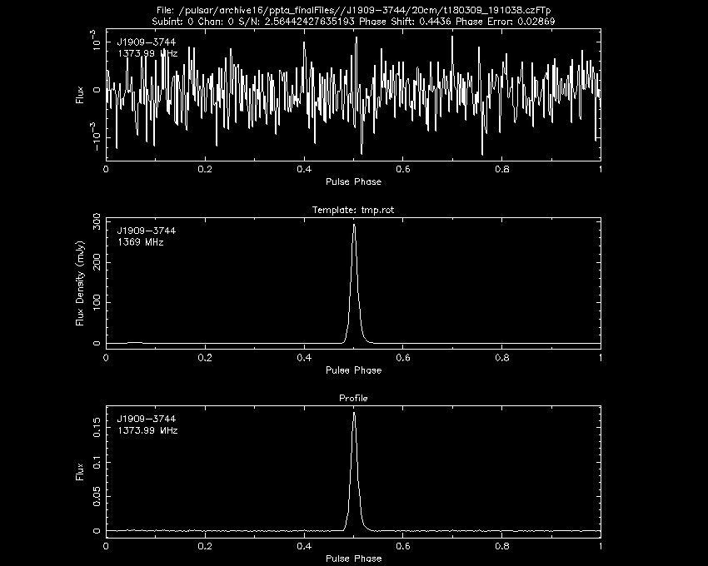
What can PSRCHIVE do?
Estimate times of arrival (pat)
“time tagging”
Shift the noise-free template in phase until it matches the data
Relative to timing model arrival times varied show excess white noise due to pulse jitter
Millisecond pulsars easily measured to less than 1 microsecond precision
TOA (MJD) 58186.821751361541342
Error (microsec) 0.029

Slide 28
Saving times of arrival (ToAs)
Measured ToAs are saved to a text file (.tim file) with flags describing the observation
File name
Frequency (MHz)
ToA (MJD)
Uncertainty (us)
Telescope
Flags
Pulsar timing data sets often have thousands of ToAs

Slide 29
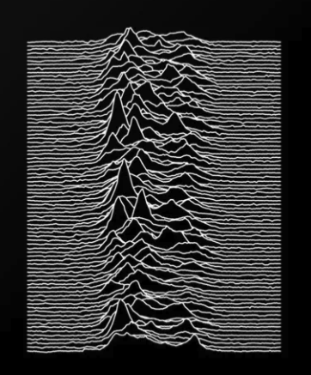
Summary
The journey of pulsar timing data
Big radio telescopes in radio-quiet regions observe pulsars for minutes to hours
Receivers transform radio waves to voltages
A backend system folds data at the pulsar period and saves profiles as a function of frequency, time, and polarization
PSRCHIVE is used to
Remove Radio-frequency interference (RFI)
Calibrate observations
Sum profiles in frequency, time, polarization
Form templates profiles
Time tag profiles with precise times of arrival (ToAs)
https://github.com/andrewzic/IPTA_PSRCHIVE_tutorial_2024
Timing residuals are then analyzed for interesting physics missing in the model
Gravitational waves!

Slide 30
Bonus: Software to use
Voltages processed (e.g. folded) with dspsr
Search mode searched for new pulsars with presto
Pulse profiles calibrated and analysed with psrchive
Timing residuals and (least squares) timing model fit in tempo2 or PINT
Stochastic (random) processes, and timing model fit with Bayesian inference with temponest or enterprise
Gravitational wave detection enterprise and discovery

Slide 31
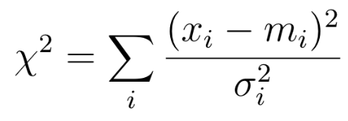
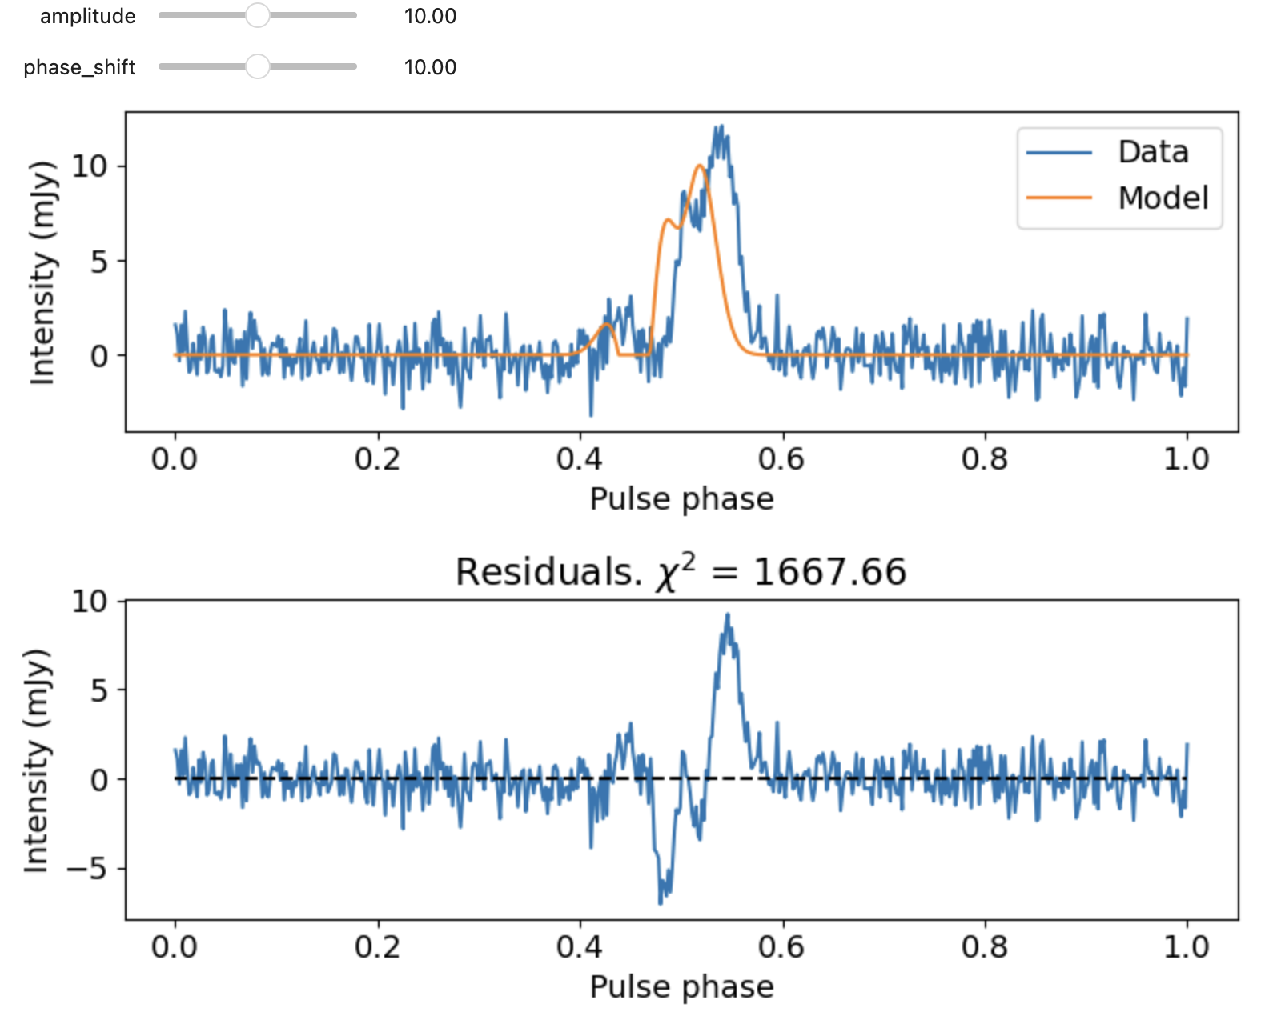
Time tagging
Match a template to the pulse profile observation
Shift the template in phase until it best matches the data
Relative to timing model arrival times varied show excess white noise
Millisecond pulsars easily measured to less than 1 microsecond

Slide 32
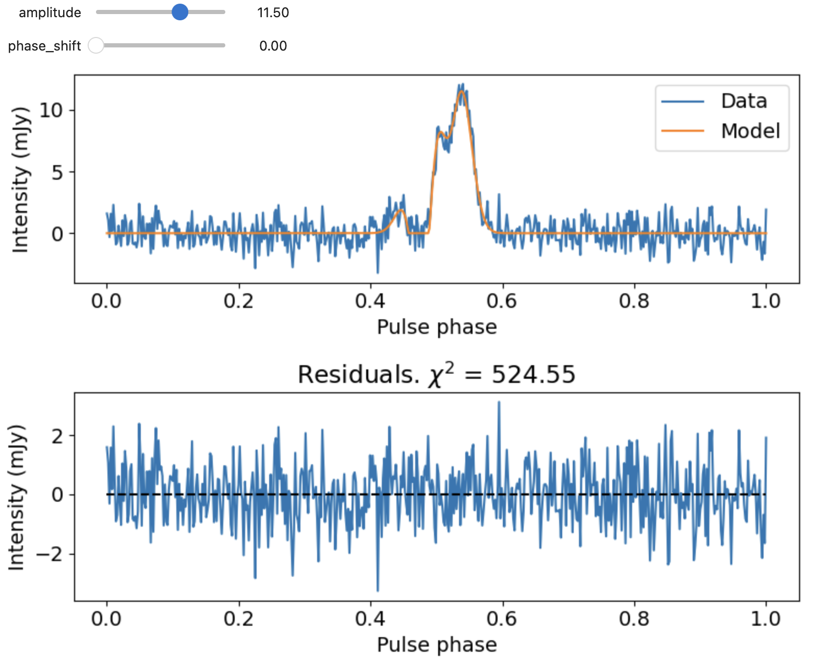
Time tagging
Match a template to the pulse profile observation
Shift the template in phase until it best matches the data
Relative to timing model arrival times varied show excess white noise
Millisecond pulsars easily measured to less than 1 microsecond

Slide 33
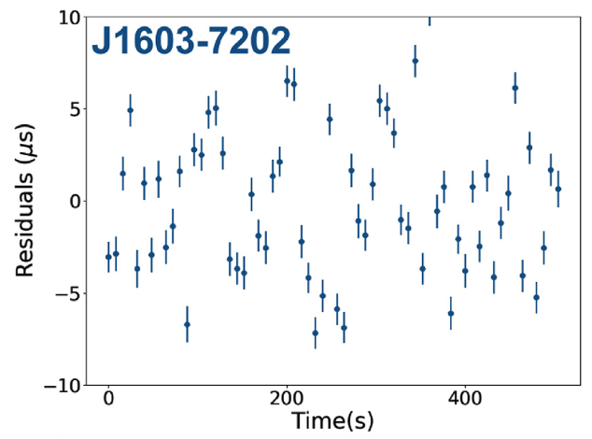
ToA uncertainty
What properties of telescope/receiver/pulsar give the best ToAs?
Best millisecond pulsars can be time-tagged to 10 nanoseconds uncertainty!
However, measurements often show excess noise
Jitter noise in J1603-7202 (Parthasarathy et al. 2021)

Slide 34
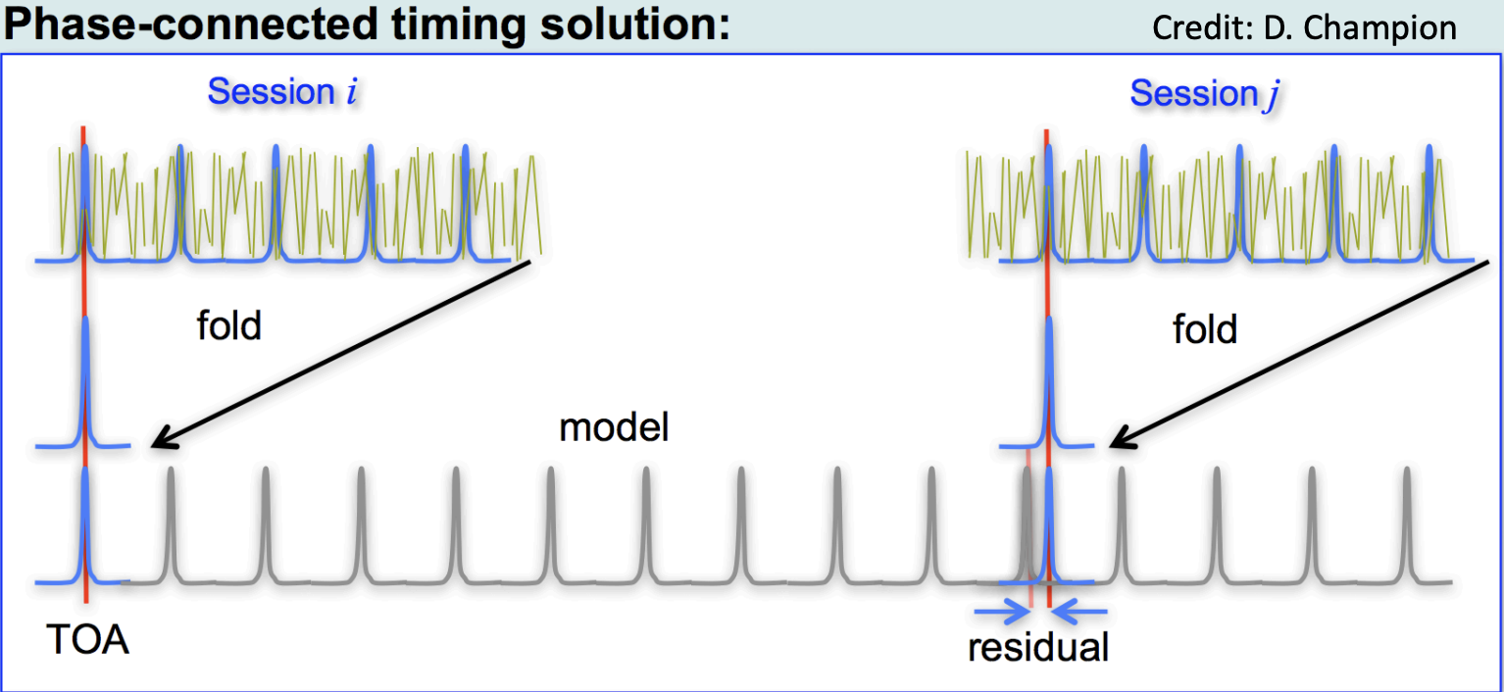
Timing residuals
A model is used to predict the arrival times
The model is developed following the discovery of a pulsar
It is always improving with more data collected
Timing residuals = ToAs – model
Timing residuals reveal physics missing from the model.

Slide 35
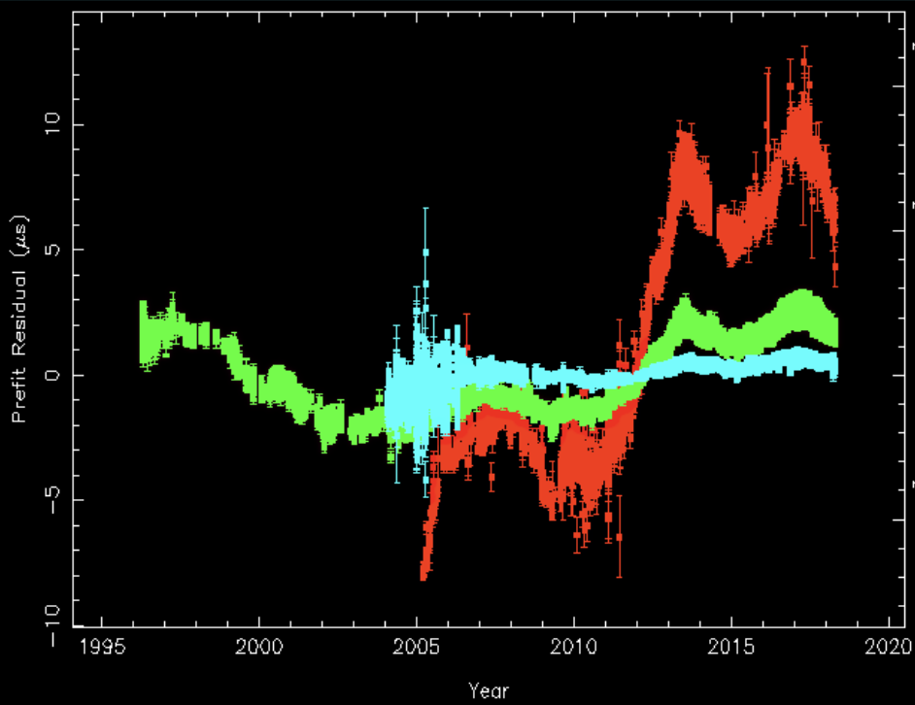
Noisy timing residuals
Observations of millisecond pulsar B1937+21
Spin noise
Dispersion measure variations in PSR J0437-4715
Last observation (2018): 674,489,762,880 pulse periods after first observation (1984)

Slide 36
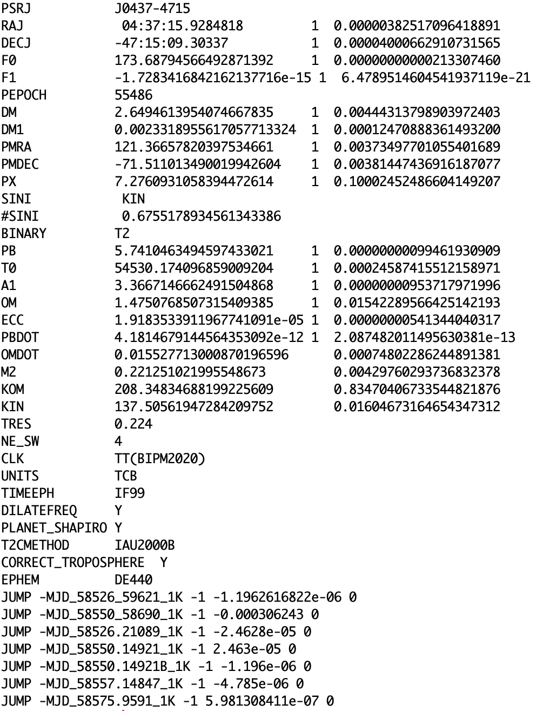
The timing model
Text file of parameters and uncertainties (.par file)
Pulsar spin
Astrometry (position, motion)
Dispersion
Keplerian binary orbit
Post-Kelperian effects (geometric, relativistic)
Solar wind / solar system
Instrumental offsets

Slide 37
More profiles
Spiewak et al. (2022)
Average over time and frequency
Pulsars have different shapes
Depends on spin properties of pulsars
Depends on viewing angle of pulsar beam
Depends on shape of emission region
Narrow pulses provide higher timing precision
Example: MeerKAT profiles of millisecond and recycled pulsars

