Slide 1
Introduction to IPTA data combination
IPTA Student Workshop 2025
Caltech, Pasadena
Prerna Rana
SARAO postdoctoral fellow, University of Cape Town
June 16th, 2025

Slide 2
Overview
What is a PTA and what is IPTA?
A small recap of timing.
What do we mean by data combination?
Steps to do data combination.

Slide 3
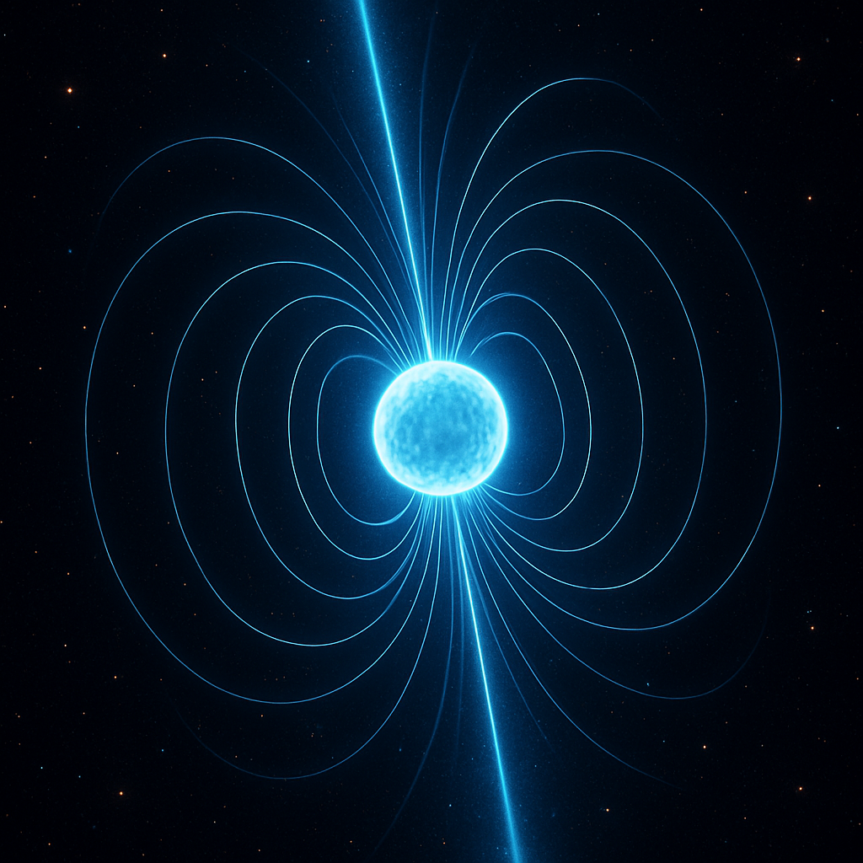
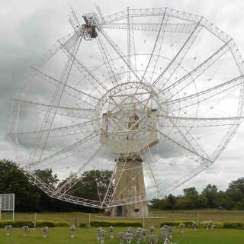
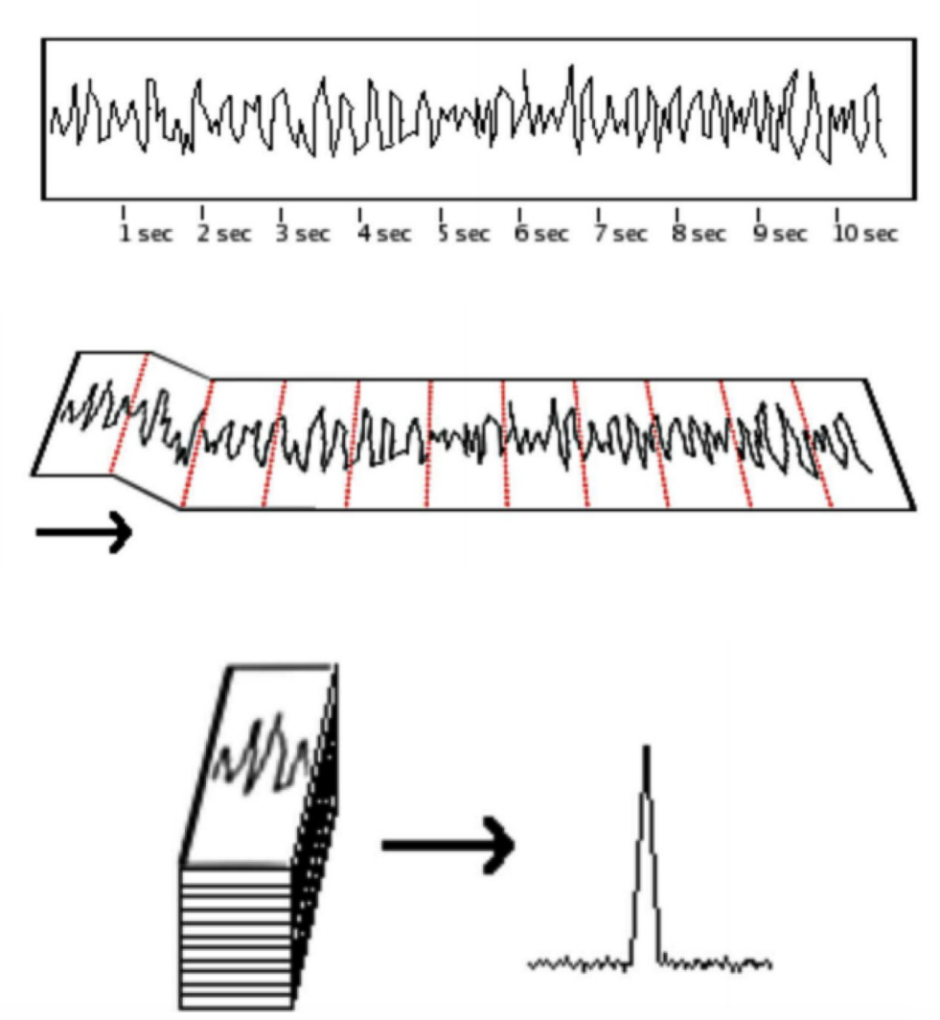
A Pulsar Timing Array (PTA) experiment

Slide 4
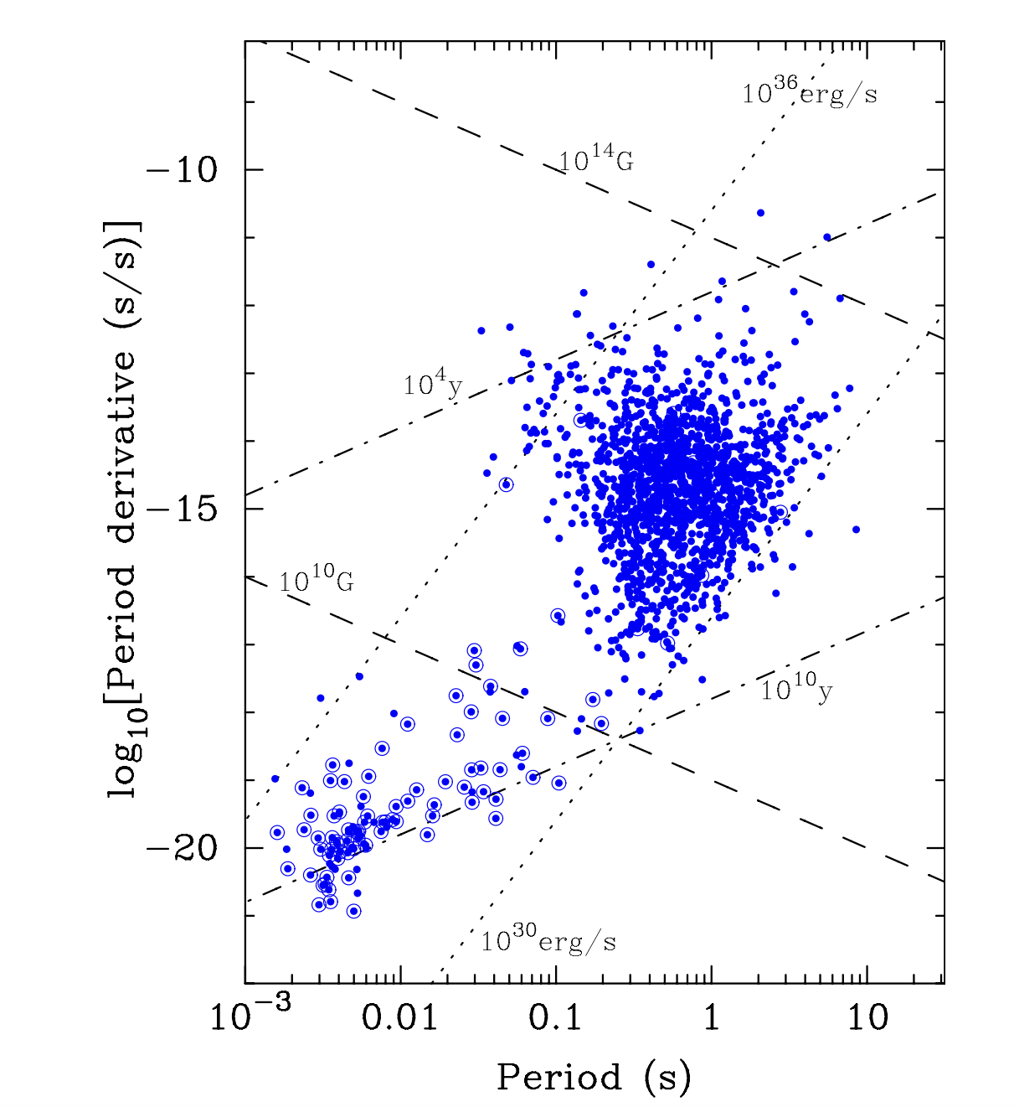
A Pulsar Timing Array (PTA) experiment
A PTA regularly monitors a bunch of millisecond pulsars (MSPs) - having highly stable spin periods - through the radio telescope(s).
Ref: D. Lorimer 2008, Living Rev. Relativity, 11, 8

Slide 5
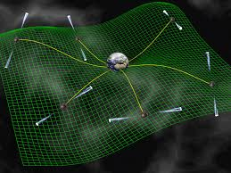
A Pulsar Timing Array (PTA) experiment
A PTA regularly monitors a bunch of millisecond pulsars (MSPs) - having highly stable spin periods - through the radio telescope(s).
Galaxy-scale detector with arms extending between Earth and each pulsar.
Aim is to discover and characterise very low Gravitational Waves (nanoHertz).
Credit: David Champion
Ref: D. Lorimer 2008, Living Rev. Relativity, 11, 8

Slide 6
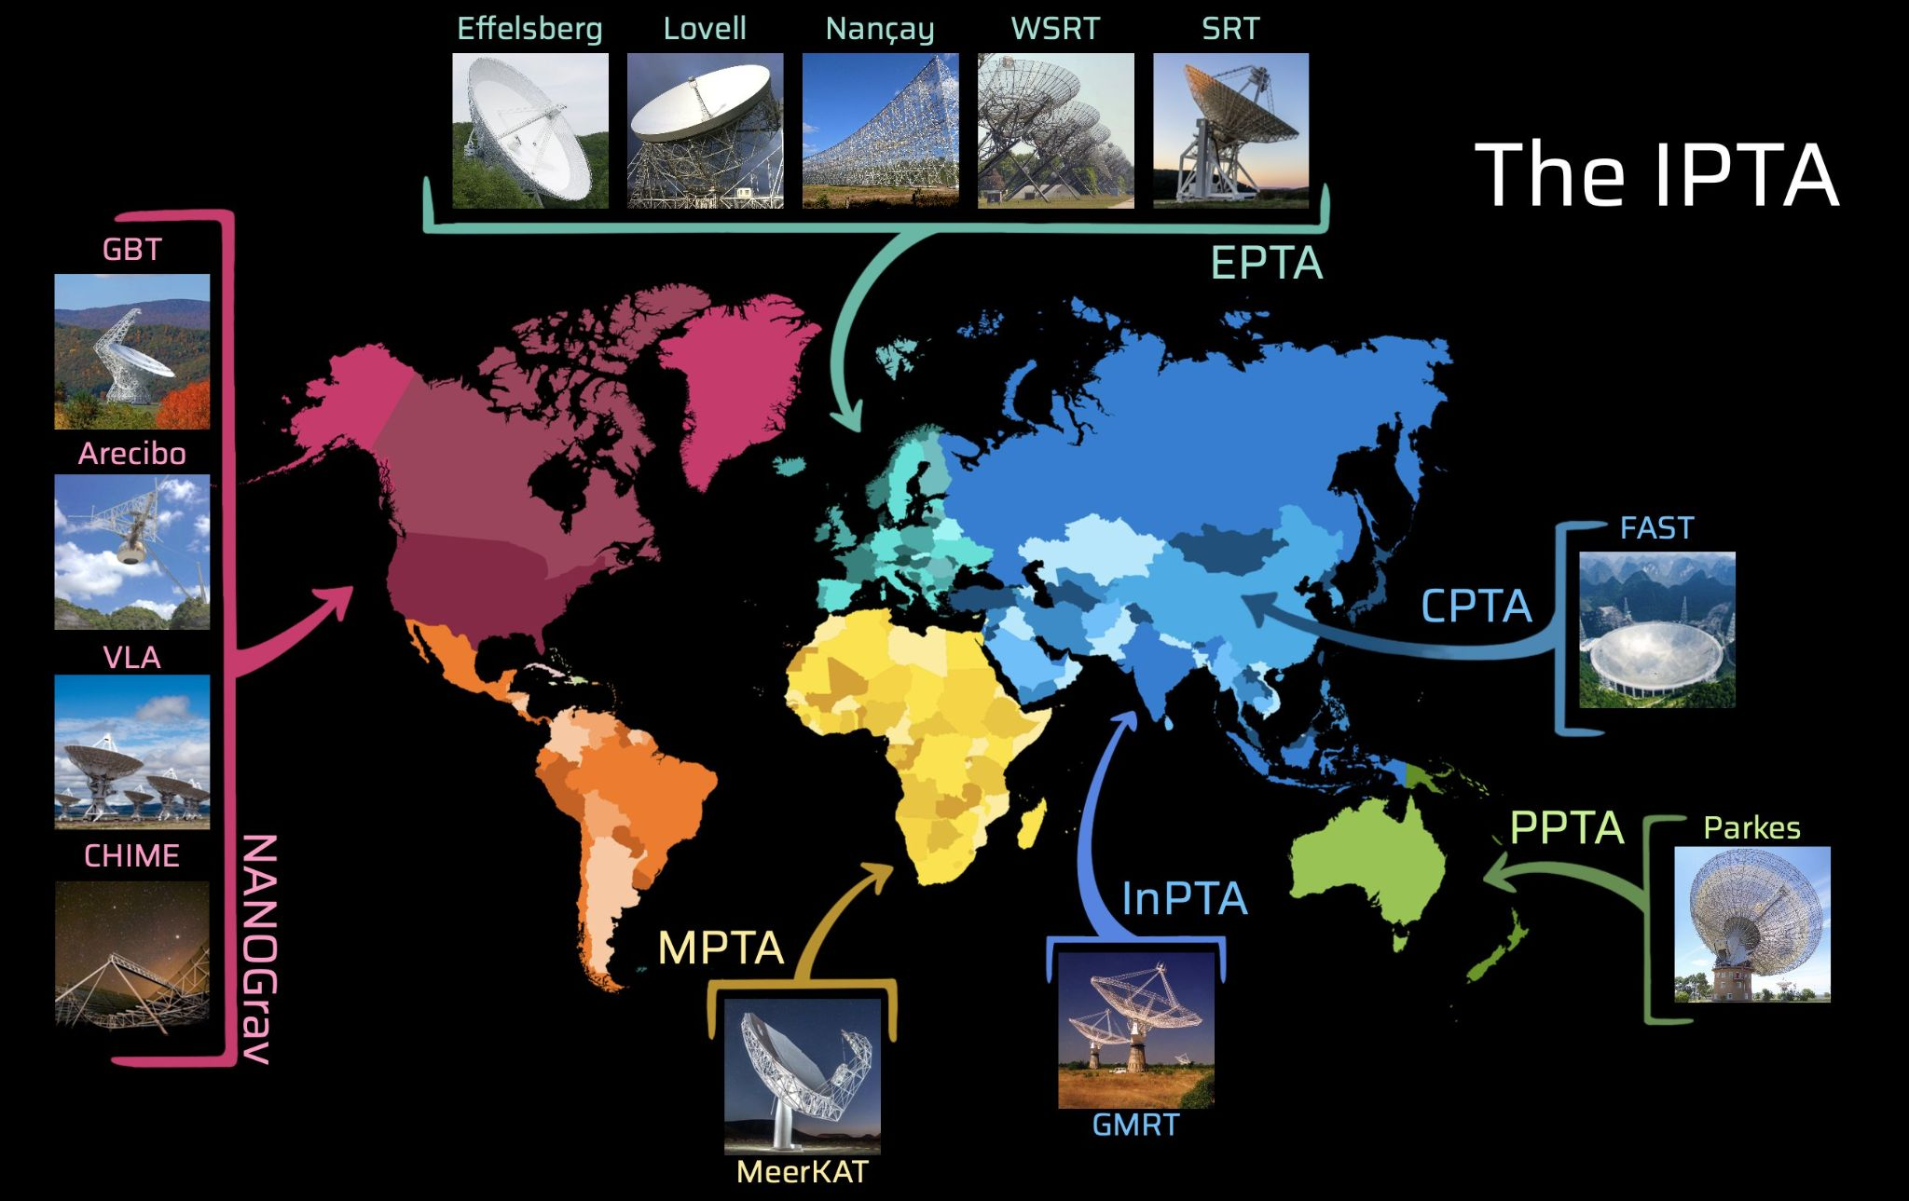
The International Pulsar Timing Array (IPTA)
The IPTA is a consortium of consortia.
The IPTA combines dataset from EPTA+InPTA+NANOGrav+PPTA+APT+MPTA+CPTA
More number of pulsars covering both hemispheres, ~121 pulsars.
Large time baseline.
Large radio frequency coverage.
Credit: Dr. Thankful Cromartie

Slide 7
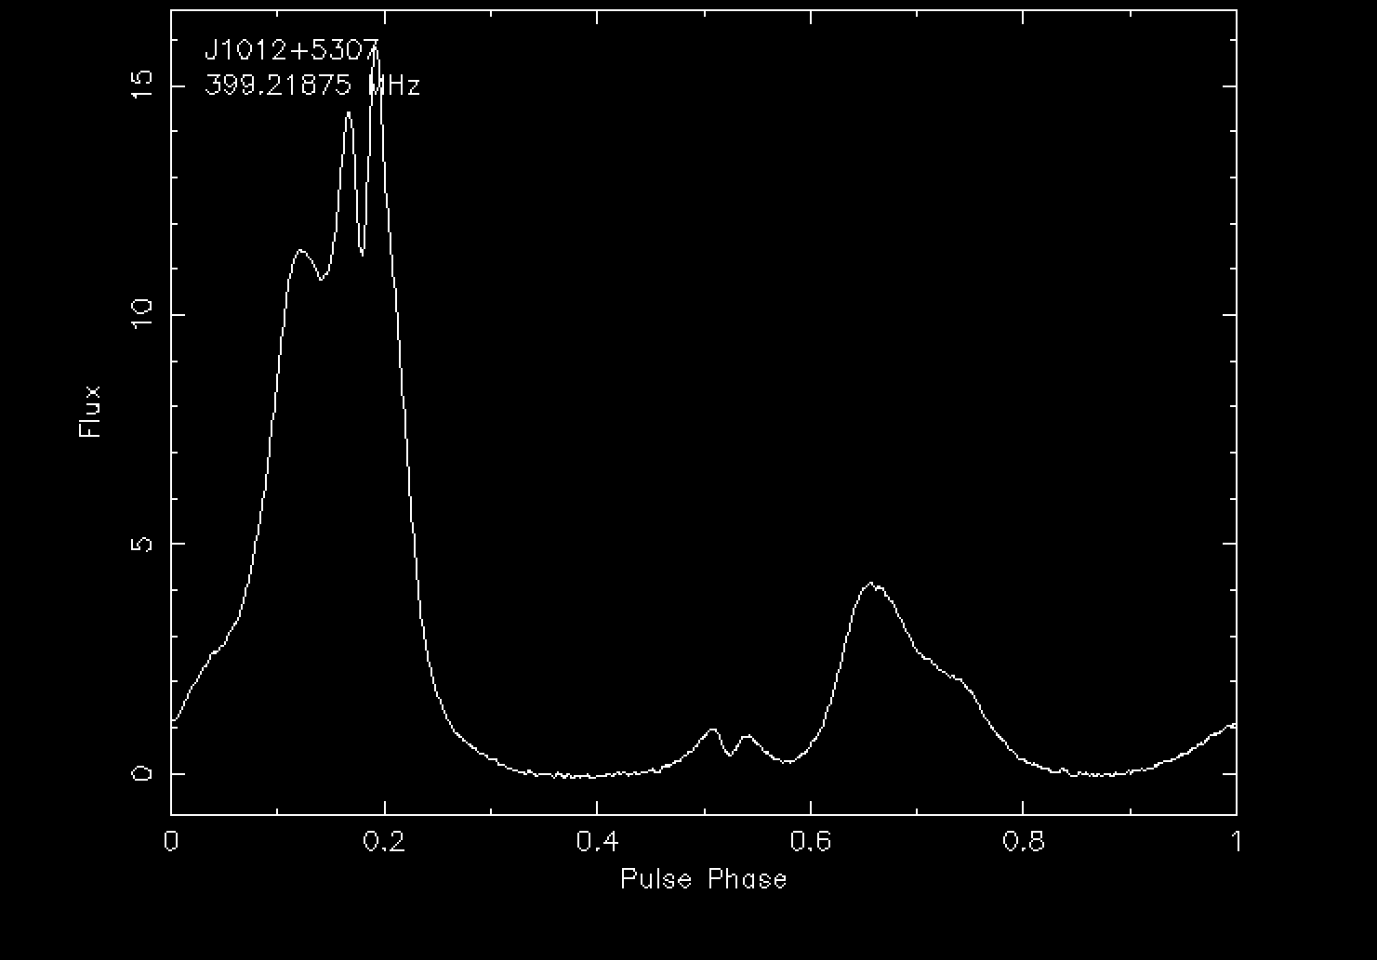
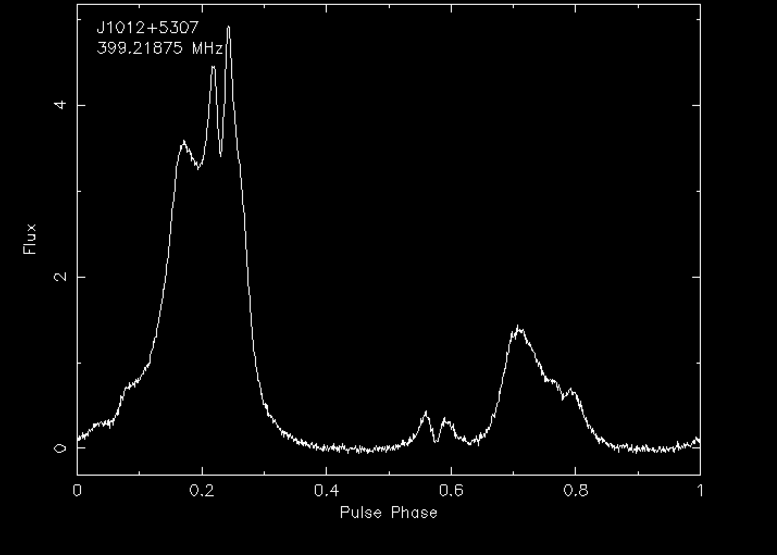
Recap of pulsar timing
PSR J1012+5307
noise-free reference template
Generating TOAs
Existing Timing model is used to fold the data -> average pulse profile.
The average pulse profile is like a unique fingerprint for the pulsar.
A reference point on the profile is chosen, and the average profile is cross-correlated in the Fourier domain with the noise-free template.
Phase shift of the average profile is calculated to estimate Time Of Arrival (TOA).
Average pulse profile
Ref: InPTA

Slide 8
Recap of pulsar timing
Pulsar Timing model:
Spin parameters
Position parameters
Binary parameters
Dispersion measure
Measured TOA from data
Measured TOA, $t_{obs},t_{err}$
predicted TOA, $t_{p}$
Timing residuals = $t_{obs}-t_{p}$
Update timing models,
the timing parameters get
more and more precise.
$$χ^{2}=Σ_{i}{\left(\frac{t_{obs}-t_{p}}{t_{err}}\right)}^{2}$$
Regression analysis is used to refine “timing model” parameters

Slide 9
Recap of pulsar timing
Pulsar Timing model:
Spin parameters
Position parameters
Binary parameters
Dispersion measure
Measured TOA from data
Measured TOA, $t_{obs},t_{err}$
predicted TOA, $t_{p}$
expected to look like white noise
Timing residuals = $t_{obs}-t_{p}$
Update timing models,
the timing parameters get
more and more precise.
$$χ^{2}=Σ_{i}{\left(\frac{t_{obs}-t_{p}}{t_{err}}\right)}^{2}$$
Regression analysis is used to refine “timing model” parameters
This whole procedure of pulsar timing is done independently by each PTA experiment to generate TOAs (tim file) and timing model (par file) of MSPs in their data releases.
Software used - Tempo2 or PINT

Slide 10
Timing residuals
PSR J1909-3744 across PTAs
PPTA DR3; Andrew Zic et al 2023
~700 MHz to 4 GHz
EPTA DR2; J. Antoniadis et al 2023
~350 MHz to 4.8 GHz
NG 15 yr; G. Agazie et al 2023
~400 MHz to 3 GHz
InPTA DR1; P. Tarafdar et al 2022
~300 to 1460 MHz

Slide 11
Data combination - Pooling data together
CPTA
EPTA
InPTA
NANOGrav
MPTA/APT
PPTA
Combined TOAs
Pulsar timing
Refit parameters
Updated and more
precise timing
model

Slide 12
Data combination - Pooling data together
CPTA
EPTA
InPTA
NANOGrav
MPTA/APT
PPTA
Combined TOAs
We need to phase align the dataset.
Take care of frequency dependent pulse profile evolution.
Take care of offset between reference DMs.
Pulsar timing
Refit parameters
Updated and more
precise timing
model

Slide 13
Steps to do data combination
PSR J1012+5307
noise-free reference template
1. Phase align the dataset
Each PTA makes a noise-free template of a given pulsar independently to generate TOAs.

Slide 14
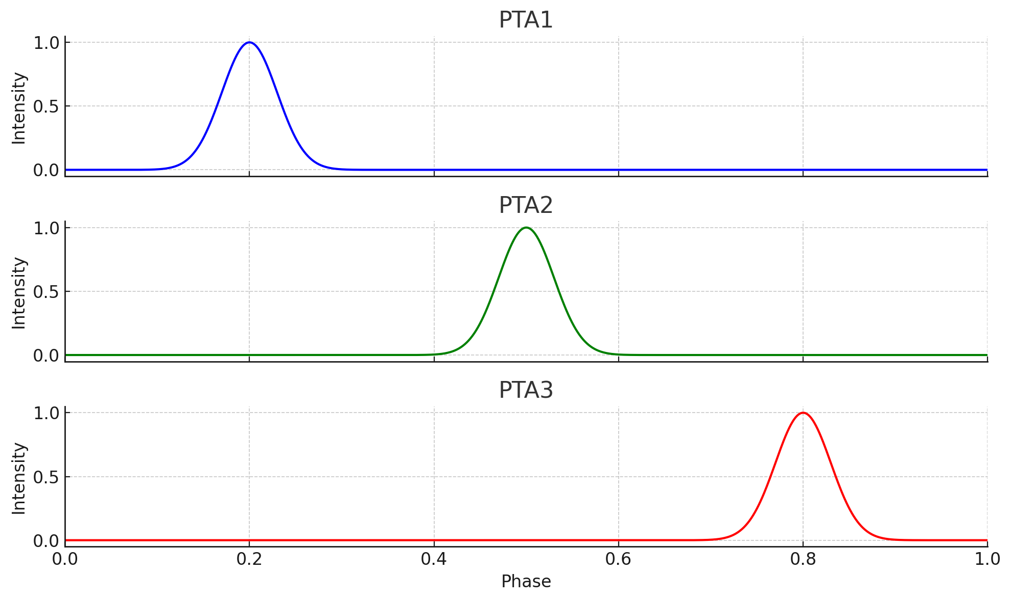
Steps to do data combination
PSR J1012+5307
noise-free reference template
1. Phase align the dataset
Each PTA makes a noise-free template of a given pulsar independently to generate TOAs.
These template are not expected to be phase aligned across PTAs. They are associated with different telescopes/backend.

Slide 15
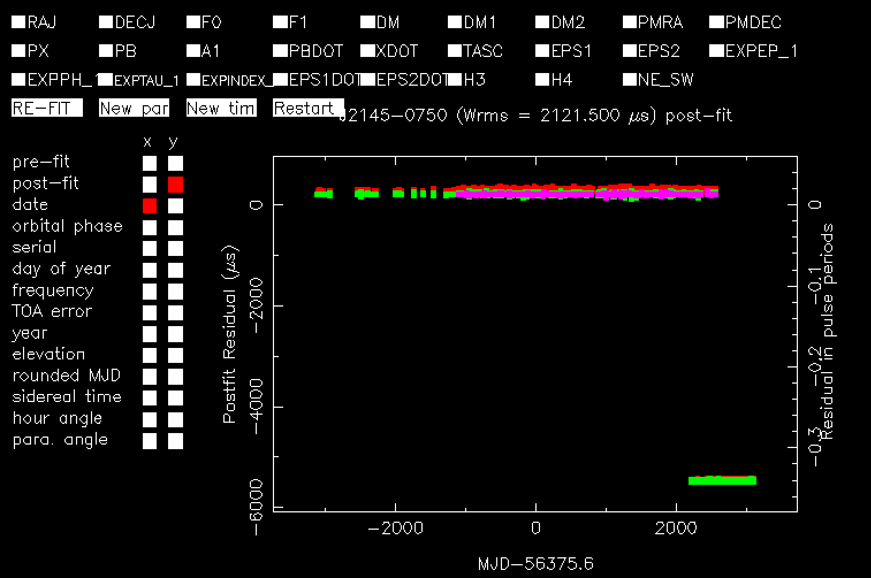
Steps to do data combination
PSR J1012+5307
noise-free reference template
1. Phase align the dataset
Each PTA makes a noise-free template of a given pulsar independently to generate TOAs.
These template are not expected to be phase aligned across PTAs. They are associated with different telescopes/backend.
This create a phase/time offset between TOAs of different PTAs.
MPTA DR1
NG 15 yr
Oh, scary!

Slide 16
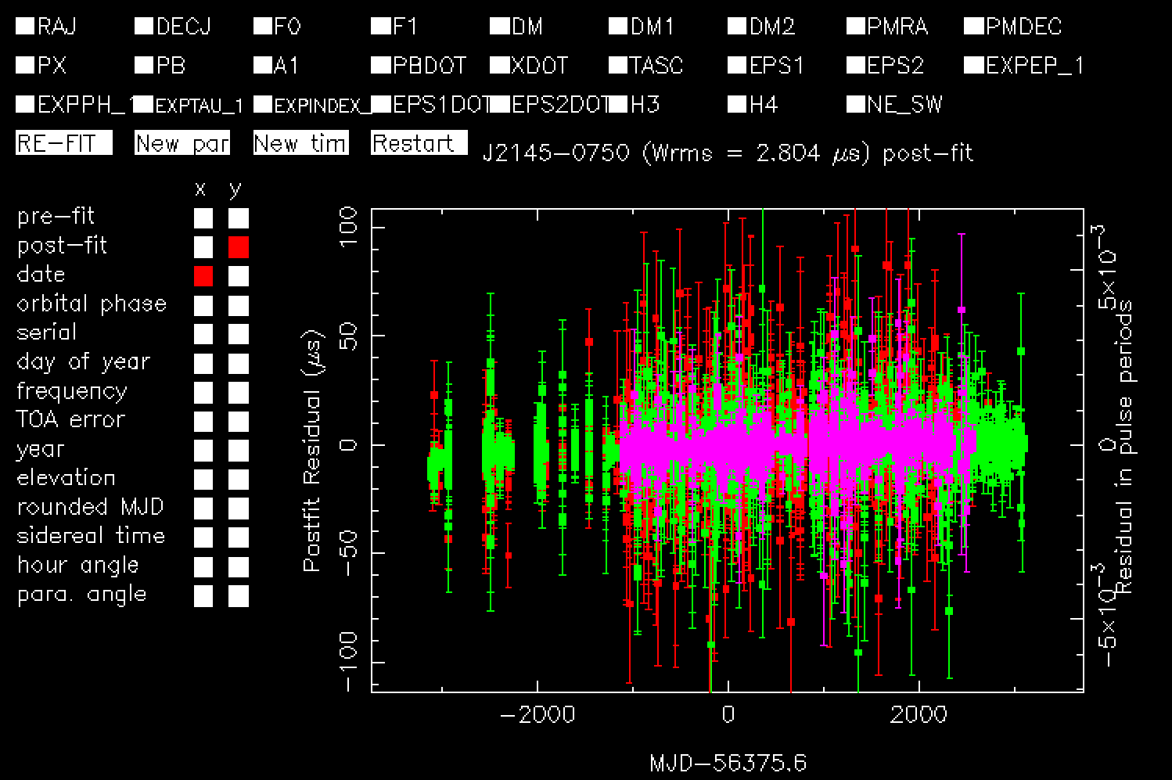
Steps to do data combination
Solution - we need phase jump wrt a reference PTA
Fit a phase JUMP parameter to align TOAs of PTAs.
Phase aligned, yay!

Slide 17
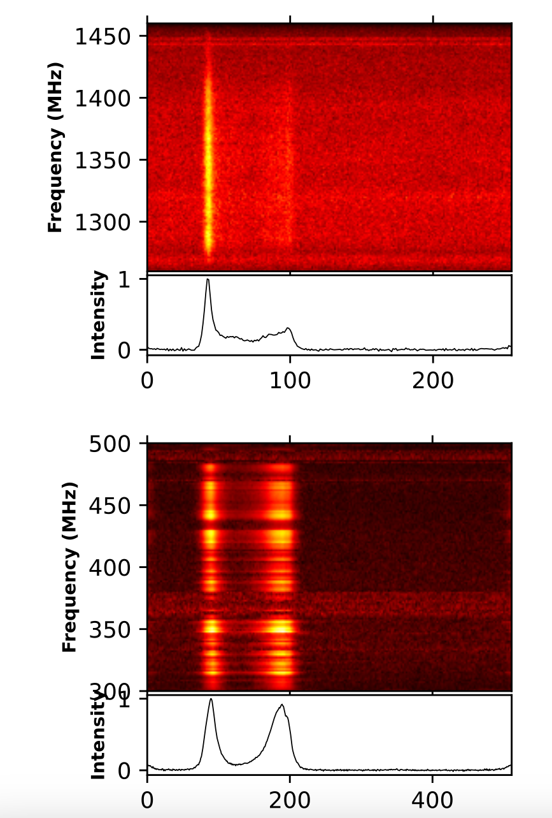
Steps to do data combination
PSR J2145-0750
2. Frequency-Dependent pulse profiles
Pulse profile shapes vary with radio frequency.
Ref: InPTA

Slide 18
Steps to do data combination
PSR J2145-0750
2. Frequency-Dependent pulse profiles
Pulse profile shapes vary with radio frequency.
If a single averaged template is used to cross-correlate with profiles varying with radio frequency.
This produces small systematic frequency-dependent (FD) delay in the TOAs.
Ref: InPTA

Slide 19
Steps to do data combination
PSR J2145-0750
2. Frequency-Dependent pulse profiles
Pulse profile shapes vary with radio frequency.
If a single averaged template is used to cross-correlate with profiles varying with frequency.
This produces small systematic frequency-dependent (FD) delay in the TOAs.
Generally resolved by using a heuristic approach to remove FD bias
FD or FDJUMP parameters
Ref: Arzoumanian et al. 2015 NANOGrav 9-year data release
Ref: InPTA

Slide 20
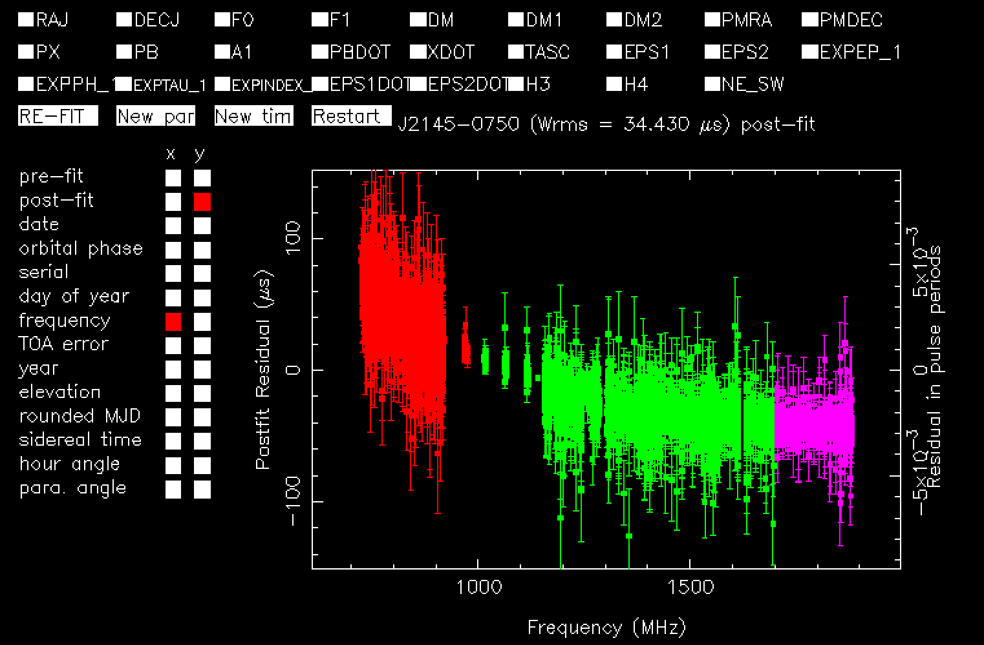
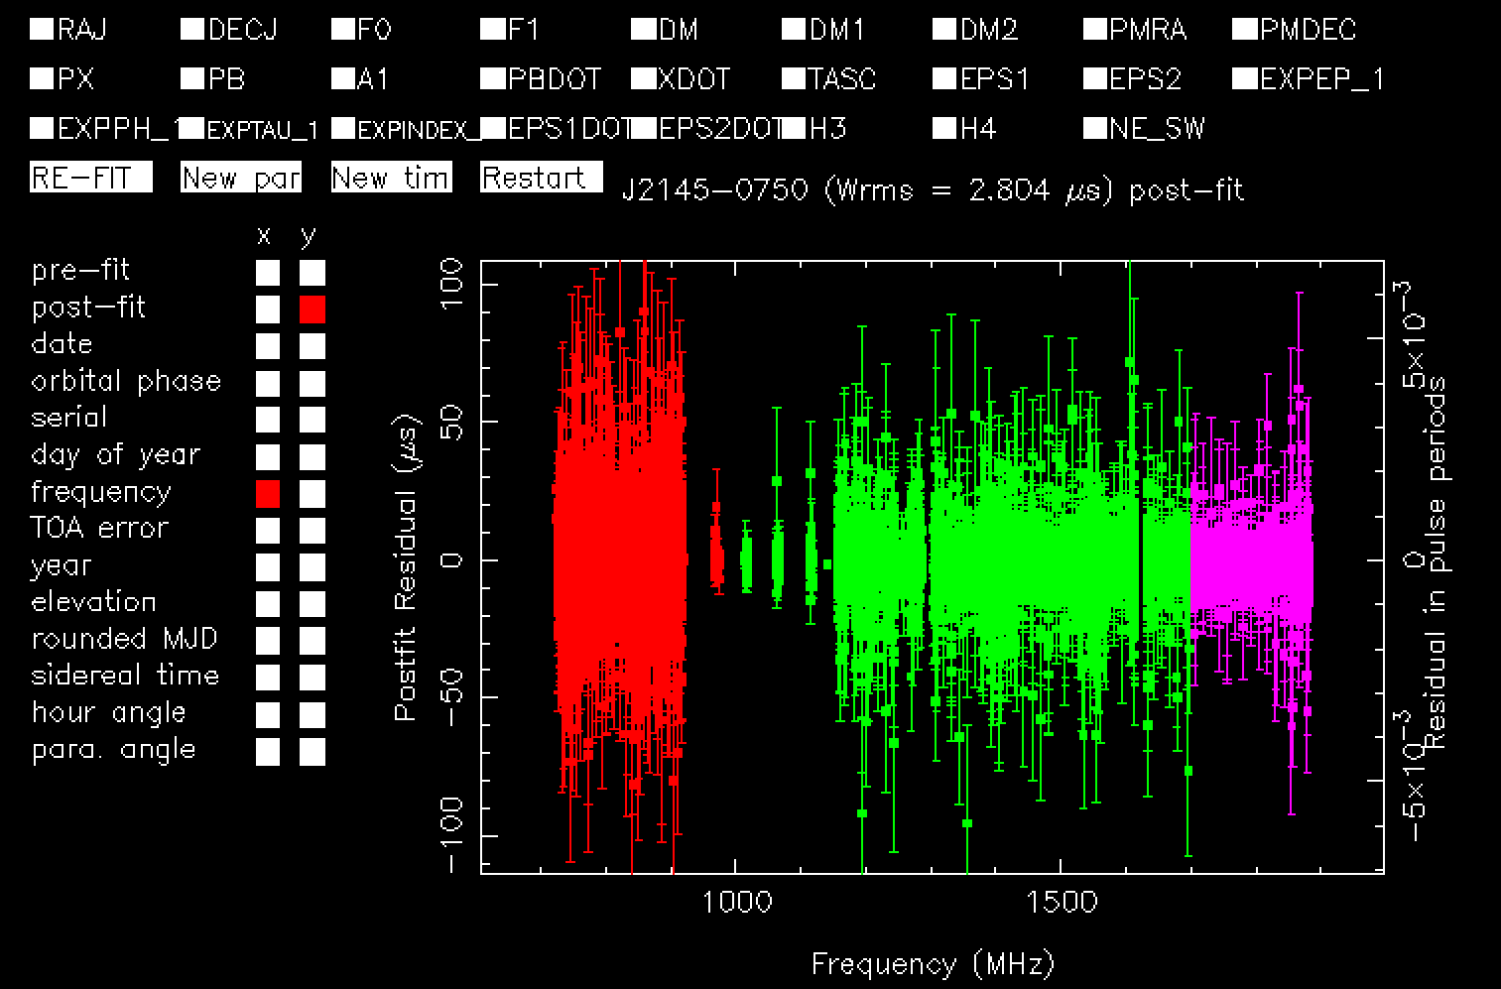
Steps to do data combination
Taking care of FD bias
Without FDJUMP parameter fitted
With FDJUMP parameter fitted

Slide 21
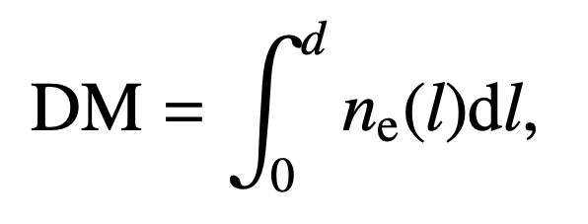
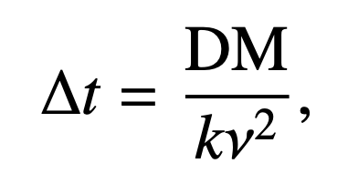
Steps to do data combination
3. Differences in reference DM
Light from a pulsar passes through interstellar medium (ISM) - plasma of ionised particles - before it reaches the telescope.
Dispersion measure (DM) - integrated electron column density - important to include in timing model
This induces an additional delay ∆t in the ToAs.

Slide 22
Steps to do data combination
3. Differences in reference DM
Light from a pulsar passes through interstellar medium (ISM) - plasma of ionised particles - before it reached the telescope.
Dispersion measure (DM) - integrated electron column density - important to include in timing model
This induces an additional delay ∆t in the ToAs.
ISM is dynamic along the line the sight of the pulsar.
DM varies with time.
Ref: InPTA-DR2

Slide 23
Steps to do data combination
Taking care of differences in reference DM
We need to model variation of DM as a function of time.
Solution: A DM jump parameter between PTAs should be fitted FDJUMPDM
Reference DM
PTA dependent

Slide 24
Summarise
The aim of IPTA data combination is to combine TOAs from various PTAs and obtain a homogenised and more precise timing model.
Phase JUMP to align TOAs across PTAs.
PTA dependent FD/FDJUMP parameters.
Take of offsets between reference DM among PTAs.
Let’s learn more by playing around with the tutorial.

